Slide 1
Human genetics and drug discovery: the future is now
Robert Plenge, MD, PhD
Broad Institute
Medical and Population Genetics (MPG)
October 1, 2015

Slide 2
The Problem

Slide 3
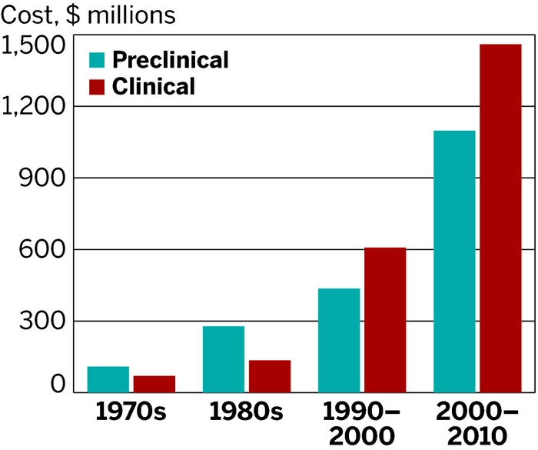

Two key challenges in drug development: high failure rate and insufficient innovation
Phase II/III failures drive high cost of drug development
Rising healthcare costs
driving demand for innovative, breakthrough therapies
US Healthcare Spending
$2.9 TRILLION
in 2013
Hospital
Care
32%
Physicians
and Clinics
20%
Prescription
Drugs
~10%
Attrition problem
Innovation problem
http://www.cms.gov/Research-Statistics-Data-and-Systems/
Statistics-Trends-and-Reports/NationalHealthExpendData/National
HealthAccountsHistorical.html
http://csdd.tufts.edu/

Slide 4
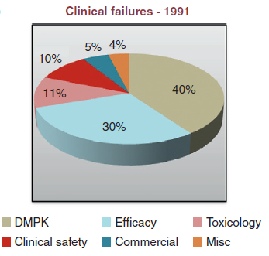
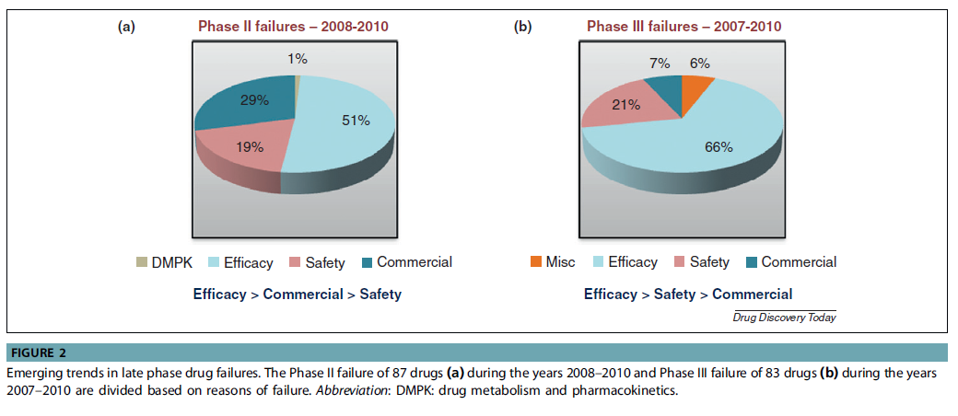
The Attrition Problem
…now it is efficacy/safety
It was drug metabolism &
pharmacokinetics (DMPK)…

Slide 5

The Innovation Problem
“to be Earth’s most customer-centric company, where customers can find and discover anything they might want to buy online, and endeavors to offer its customers the lowest possible prices”

Slide 6
What are guiding principles?

Slide 7
Target ID and Validation
Lead Optimization
Early Development
Causal Human Biology
Which targets, when perturbed, have a desired effect on human physiology?
Which biomarkers measure therapeutic modulation in
a human system?
Target Modulation Assays
How can we safely test therapeutic hypotheses in humans as quickly and efficiently as possible?
Proof-of-concept Clinical Trials
Phase II-III
Clinical Trials
Prediction: increase probability of success for breakthrough therapies

Slide 8
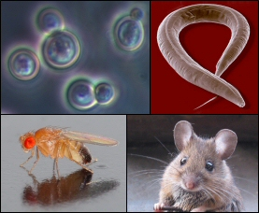

Technology is changing the ideal model organism for drug discovery and development
It was…
Target ID and Validation
Lead Optimization
Early Development

Slide 9

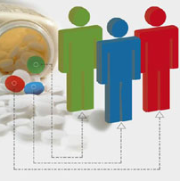
Today, humans are the model organism of choice for new targets and precision medicine
Target ID and Validation
Lead Optimization
Early Development

Slide 10
Three examples

Slide 11
Target ID and Validation
Lead Optimization
Early Development
Causal Human Biology
Which targets, when perturbed, have a desired effect on human physiology?
Which biomarkers measure therapeutic modulation in
a human system?
Target Modulation Assays
How can we safely test therapeutic hypotheses in humans as quickly and efficiently as possible?
Proof-of-concept Clinical Trials
Phase II-III
Clinical Trials
Prediction: increase probability of success for breakthrough therapies

Slide 12
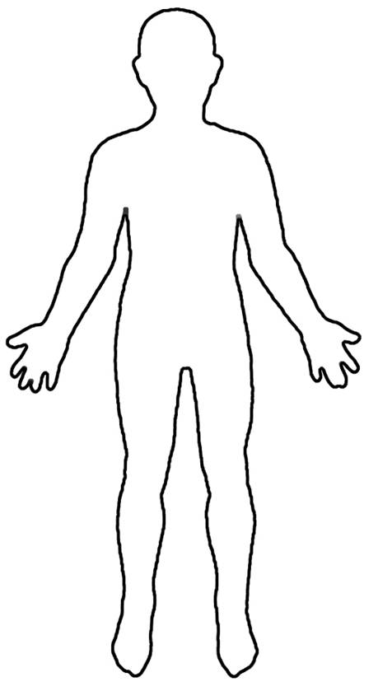



Human genetics helps to identify potential drug targets to kick-start drug discovery
“Drug”
But, tens of thousands of potential targets…
“Target”
?
…and which one causes disease?
…and how do you perturb the target?
Disease
Healthy
The key steps are:
Map genetic differences in those with disease vs healthy;
Understand how these genetic differences lead to disease;
Develop drugs against these targets that reverse disease processes in the population.
“Drug”
vs
Disease
Healthy

Slide 13
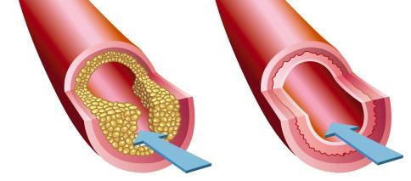
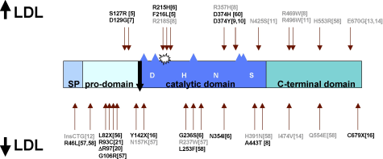
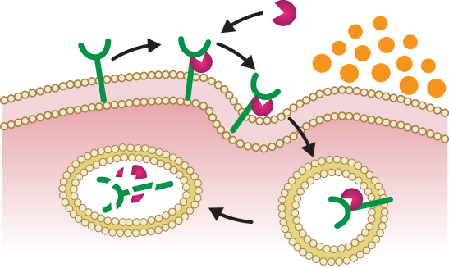
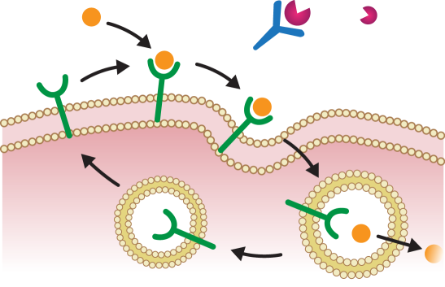


There are anecdotal examples of human genetics leading to new drug targets (PCSK9)…
Many genes influence cholesterol levels and risk of heart disease
PCSK9 mutations associated with high and low LDL cholesterol levels (and heart disease risk)
Atherosclerotic
Plaque
Blood Flow
…and design studies to find drugs that fix the underlying molecular defects – for example, blocking PCSK9 lowers LDL (or “bad”) cholesterol in the blood.
PCSK9
LDLR
LDL-C
mAb
LDLR
Recycling
Lysosome

Slide 14
…including many approved therapies, and…
Plenge, Scolnick, Altshuler, Nature Reviews Drug Discovery (2013)

Slide 15
…portfolios of drug targets with human genetic support have a higher probability of success
Notes:
See link: http://www.fastercures.org/assets/Uploads/VOD-TranslationalResearch.pdf

Slide 16
…portfolios of drug targets with human genetic support have a higher probability of success

Slide 17
What is a genetic strategy?

Slide 18
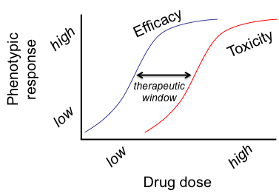
Target ID and Validation
Lead Optimization
Early Development
Phase II-III Clinical Trials
We aspire
to determine
dose-response at the time of target ID and validation
We determine
dose-response in clinical trials, after many years and millions of dollars

Slide 19
Pick a human phenotype for drug efficacy
X
High
X
Identify a series of alleles with range of effect sizes in humans (but of unknown function)
X
Human Phenotype
X
X
X
X
Low
GOF
LOF
Gene function

Slide 20
Pick a human phenotype for drug efficacy
Efficacy
X
High
X
Assess biological function of alleles to estimate “efficacy” response curve
X
Human Phenotype
X
X
X
X
Low
GOF
LOF
Gene function

Slide 21
New target for
drug screen!
Pick a human phenotype for drug efficacy
Efficacy
X
X
Toxicity
High
Assess biological function of alleles to estimate “efficacy” response curve
X
Assess pleiotropy as proxy for ADEs
Human Phenotype
X
X
X
This provides evidence for the therapeutic window at the time of target ID & validation.
X
Low
GOF
LOF
Gene function

Slide 22
The list of genes with an “allelic series” is growing
Gene
GOF
LOF
PCSK9 | low CAD risk, low LDL-C | high LDL-C, high CAD risk
APP | low AD, dementia risk | high AD, dementia risk
SCN9A | pain insensitivity | neuropathy, hyperexcitability
CARD9 | low IBD risk, high risk for fungal infections | high IBD, AS, PSC risk
TYK2 | low RA, psoriasis, SLE, MS risk, high risk for PID | high T-ALL risk
IFIH1 | low T1D risk, high risk for PID | high SLE risk, AG, SM syndromes
LRRK2 |  | high PD risk
PNPLA3 | low LDL-C, TG | high NAFLD, NASH, PBC, HCC risk
… and there are further genes with protective LoF variants, for example:
SLC30A8 (T2D), NPC1L1 (CAD), APOC3 (CAD), CCR5 (HIV), MSTN (muscle), LRP5 (bone), FUT2 (norovirus resistance), KCNJ1 (HTN), CTSK (bone)

Slide 23
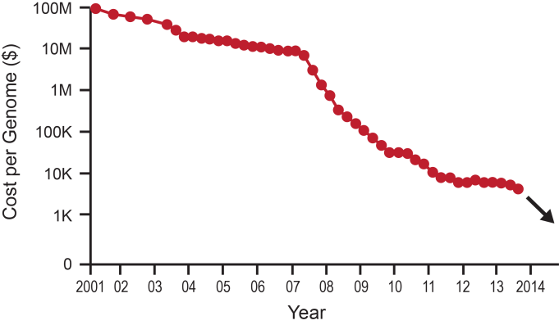
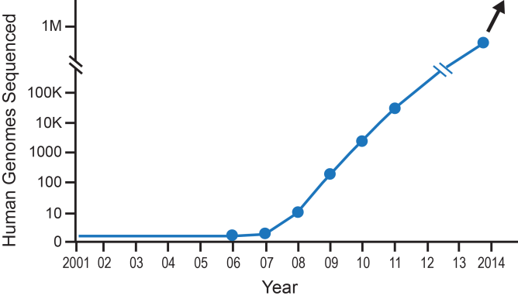
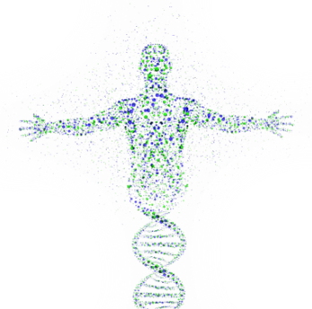
And we are at the beginning of what will be an explosion of genetic discoveries across populations
Cost of genome sequencing continues to drop rapidly…
…which results in many more human genomes being sequenced…
…and a more accurate molecular understanding of human disease.

Slide 24



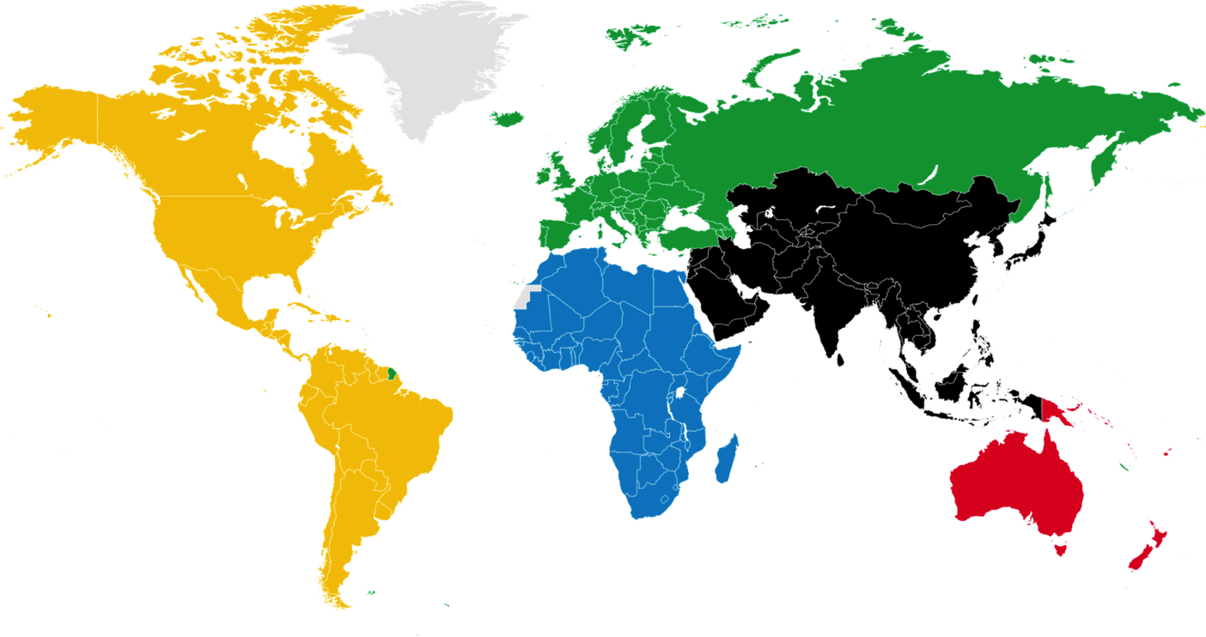


Initiatives now link human genetics with clinical phenotypes in a setting for recall
UK Biobank
HUNT/NTNU
-
Finnish Founder
Population
Kaiser-Permanente
Geisinger
INTERVAL
Estonia Precision
Medicine Initiative
Human
Longevity
NIH-AMP
Kaadorie
Biobank
Veteran’s
Administration
Saudia
Arabia
Genome
Project
Singapore
Biobank
+++
Ranking (estimates 10/2015):
+
-
size/quality of genetic data
size/quality of phenotypic data
connectivity of genetics & phenotypes
setup for recalls & ph1 trials

Slide 25
Target ID and Validation
Lead Optimization
Early Development
Causal Human Biology
Which targets, when perturbed, have a desired effect on human physiology?
Which biomarkers measure therapeutic modulation in
a human system?
Target Modulation Assays
How can we safely test therapeutic hypotheses in humans as quickly and efficiently as possible?
Proof-of-concept Clinical Trials
Phase II-III
Clinical Trials
Prediction: increase probability of success for breakthrough therapies

Slide 26
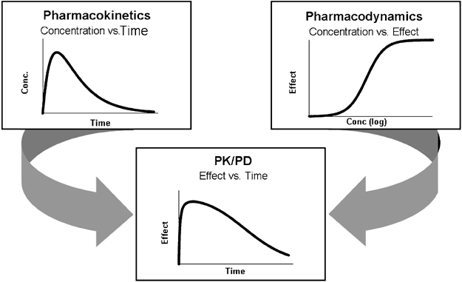
What is a biomarker?
Pharmacokinetic (PK) – what the body does to the drug
Pharmacodynamic (PD) – what the drug does to the body
Concentration vs. Time
Effect vs.
Concentration

Slide 27



Genetics can bridge biomarker with clinical data, establishing a causal link for drug discovery
C
G
I
D
vs
G
I
D

Slide 28
Retrospective example: NPC1L1 protein (target), LDL (biomarker), coronary heart disease (POC)
Sequencing NPC1L1 in >7,000 patients and >14,000 controls
Ph III clinical study in
>18,000 CHD patients
15 NPC1L1 inactivating mutations
Carriers w/ lower plasma LDL
53% relative risk reduction
32.7% vs 34.7% w/ primary event
HR=0.936, p=0.016
6.4% relative risk reduction

Slide 29
BACE-inhibitor program in Alzheimer’s disease

Slide 30
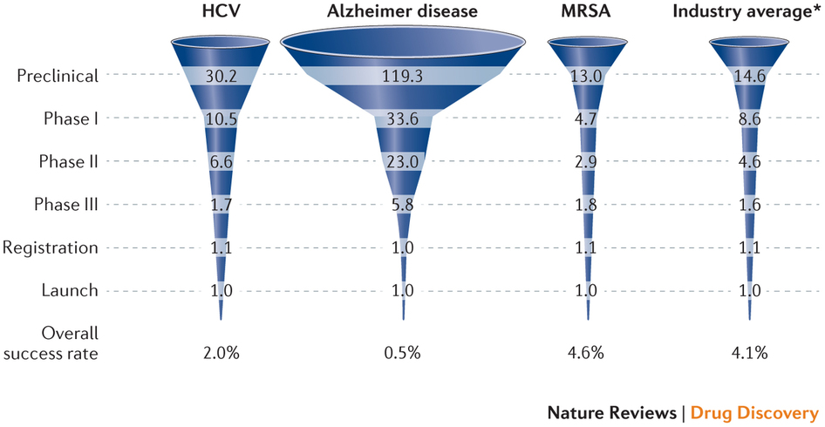
The history of drug development for Alzheimer’s disease is not pretty – very high failure rates
99.5% failure rate!
Calcoen et al (2015) NRDD

Slide 31
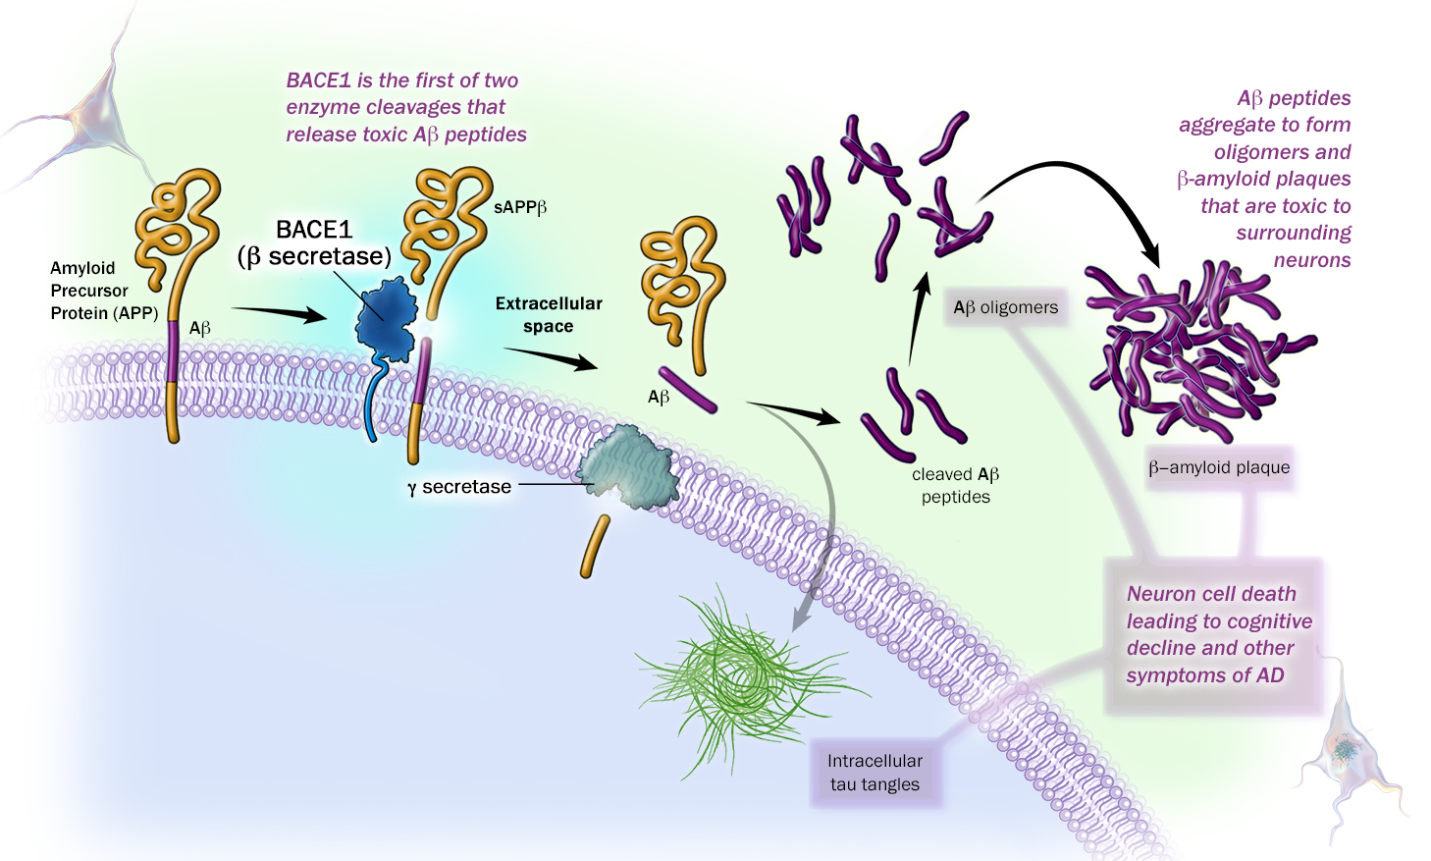
Amyloid hypothesis and Alzheimer’s disease: the role of the APP gene and BACE1 in disease initiation
Aβ oligomers
Causal human biology
APP, PSEN1, PSEN2 mutations cause FAD, increase Aβ cleavage
APP-A673T variant reduces AD risk, decrease Aβ cleavage
Naturally occurring antibodies to Aβ oligomers decrease AD risk

Slide 32
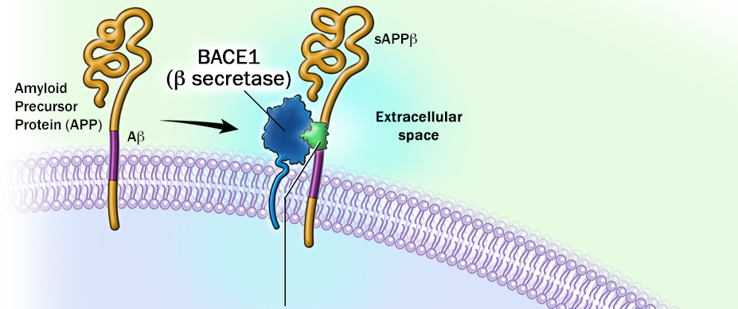
Therapeutic hypothesis: BACE-inhibition blocks release of toxic Aβ and reduces AD progression
(3) Decrease in Aβ oligomers in brain protect from AD
(1) Protective APP mutation reduces BACE1 cleavage in vitro
(2) BACE1 inhibitor mimics APP mutation and blocks first step in release of toxic Aβ peptides

Slide 33








Aβ peptide levels measured in CSF serve as a biomarker for target modulation
Drug
CSF
Biomarker
Does the drug engage and modulate the target (PD)?

Slide 34

Is there a dose-dependent relationship in human subjects?
Healthy Volunteers
Alzheimer’s Patients
Drug
Low dose
High dose
Drug
Low dose
High dose
CSF
CSF
Biomarker
Biomarker

Slide 35
MK-8931 lowers Aβ levels in CSF from healthy volunteers and Alzheimer’s disease patients
Multi-dose, healthy volunteers
Multi-dose, AD patients
CSF Aβ40 levels
>90% lowering

Slide 36
A note of caution, however:
(1) Human mutations are in APP, not BACE
(2) No Mendelian randomization study with APP mutations and CSF Ab peptide levels
(3) Phase III clinical trials are now underway – the ultimate test of a therapeutic hypothesis!

Slide 37
Target ID and Validation
Lead Optimization
Early Development
Causal Human Biology
Which targets, when perturbed, have a desired effect on human physiology?
Which biomarkers measure therapeutic modulation in
a human system?
Target Modulation Assays
How can we safely test therapeutic hypotheses in humans as quickly and efficiently as possible?
Proof-of-concept Clinical Trials
Phase II-III
Clinical Trials
Prediction: increase probability of success for breakthrough therapies

Slide 38
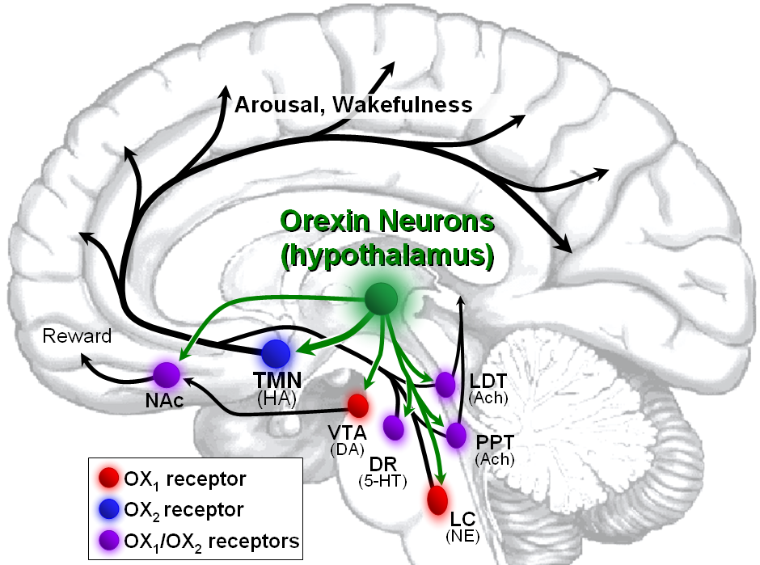
Orexin Receptor Antagonists (ORAs): a new therapeutic approach to treat insomnia
Causal human biology
Autoimmune orexin deficiency in humans results in narcolepsy
Genetic deficiency in dogs leads to narcolepsy, and orexin pathway conserved across species
Orexin
neurons
Monoaminergic
neurons
VLPO
GABAergic
neurons
Acknowledgements:
John Renger, Matt Kennedy, Mark Forman
SLEEP
SLEEP
Wake

Slide 39
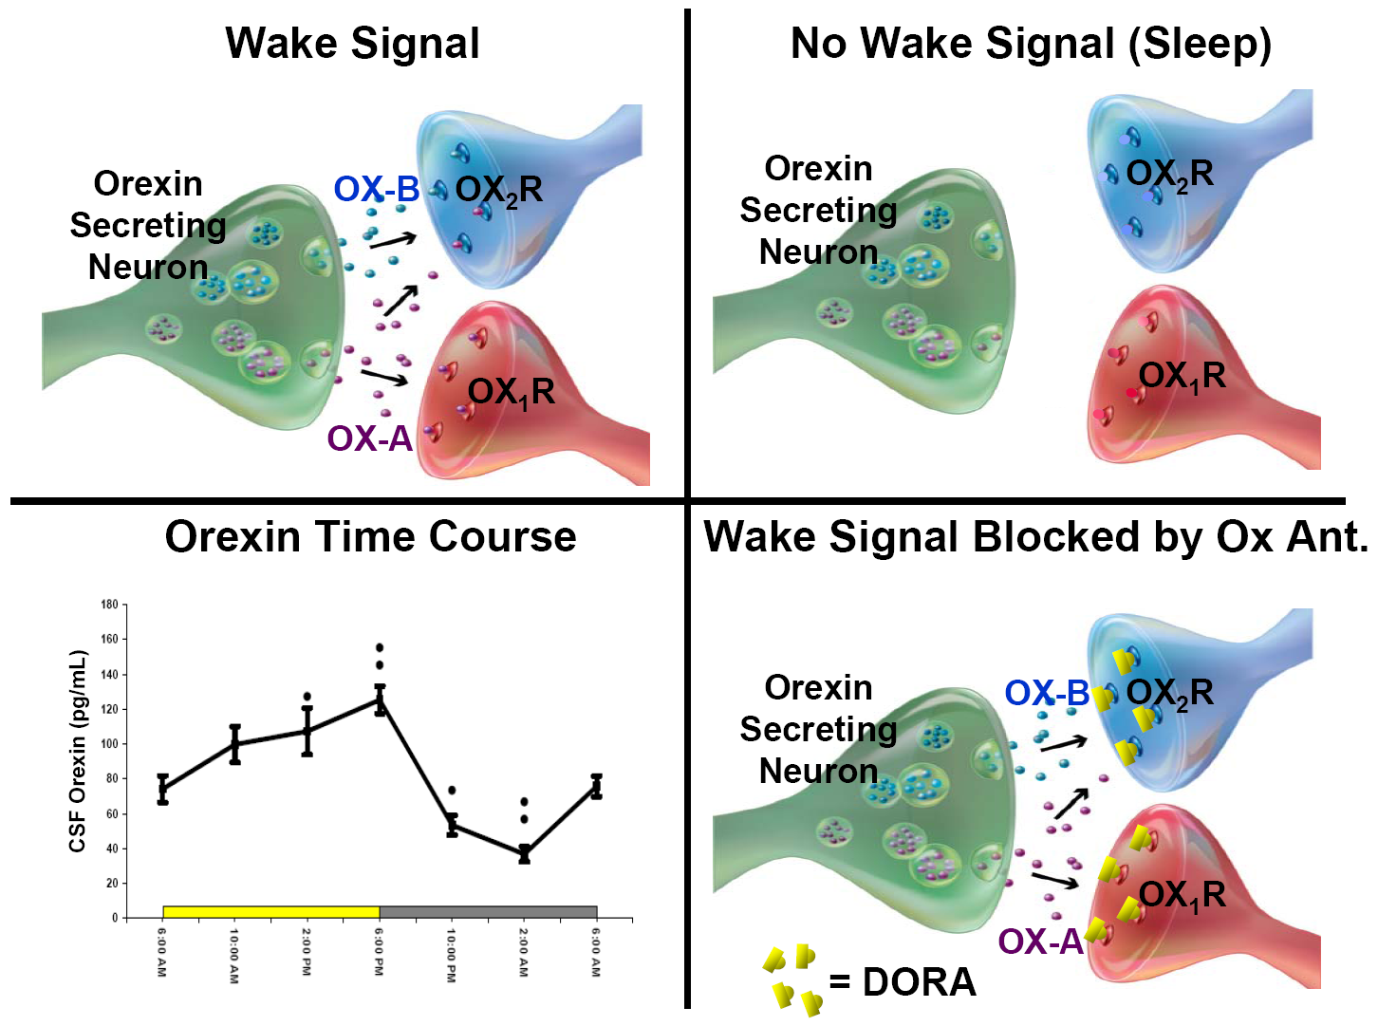
Therapeutic hypothesis: Orexin receptor antagonism (ORA) blocks wake promoting signal, enabling sleep
Orexin A (pg/ml)
Active
Inactive
Time of Day
=ORA

Slide 40
Clinical proof-of-concept (POC) in healthy volunteers: polysomnography (PSG) sleep study
Study Design: double-blinded, placebo-controlled, 5-period cross-over study in 20 healthy subjects
Measurement: 8-hr PSG recording
Total Sleep
Time
Sleep Efficiency
Index
460
96
94
450
SEI (%)
TST (min)
92
440
90
430
88
PBO
10mg
50mg
100mg
PBO
10mg
50mg
100mg
MK-4305
MK-4305

Slide 41
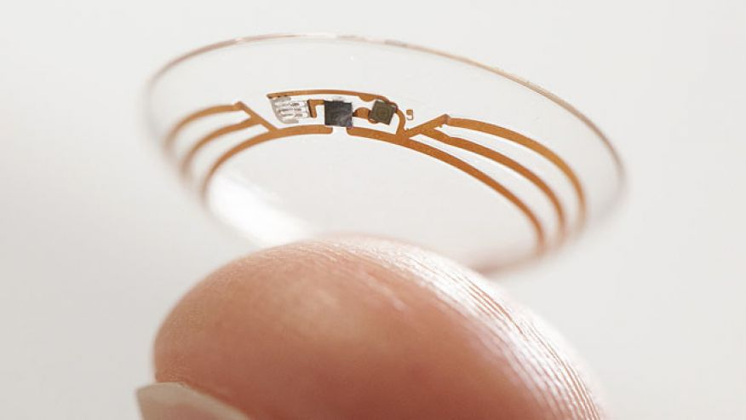
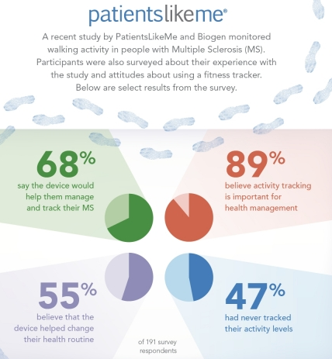

There are new technologies to measure clinical outcomes, including real-time patient monitoring

Slide 42
We live in an amazing time…
@rplenge

