Slide 1





Crowdsourcing pharmacogenomic data analysis: PGRN-Sage RA Responder Challenge
PGRN Spring Meeting
April 30, 2013
HARVARD
MEDICAL SCHOOL
Notes:
Exciting progress in finding genes that influence RA risk. But I also want to leave you with: this is the first of many challenging steps to translate to patient care.

Slide 2


Slide 3
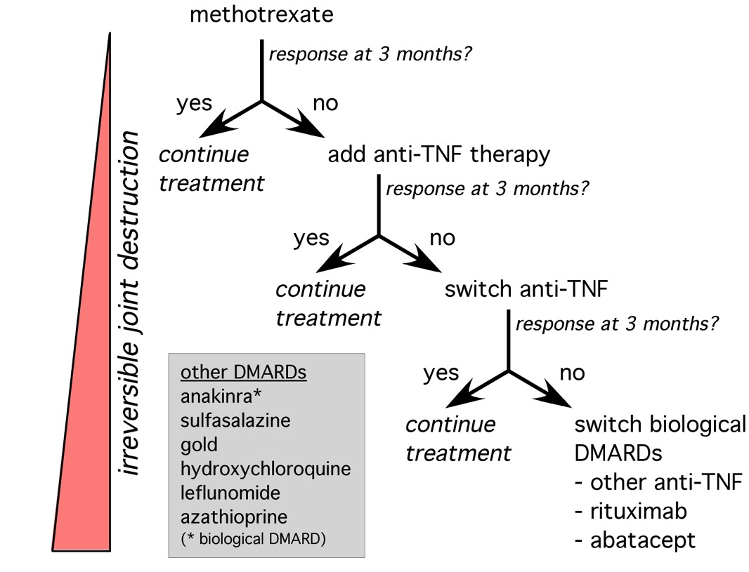
Predicting response in RA
N=2,700 RA patients
Notes:
Pharmacogenomic (PGx) studies are useful in identifying factors that lead to variation in drug response, which in turn can lead to predictive models for selecting drugs and doses based on genetic information. PGx studies may also guide target validation, an important area, which we feel represents an important product of the network. Today we will speak about both, with an emphasis on the role of Discovery within PGRN:

Slide 4
How our data are silo’d
GWAS
(n=2,700)
Notes:
Pharmacogenomic (PGx) studies are useful in identifying factors that lead to variation in drug response, which in turn can lead to predictive models for selecting drugs and doses based on genetic information. PGx studies may also guide target validation, an important area, which we feel represents an important product of the network. Today we will speak about both, with an emphasis on the role of Discovery within PGRN:

Slide 5





How our data are silo’d
GWAS
(n=2,700)
Notes:
Pharmacogenomic (PGx) studies are useful in identifying factors that lead to variation in drug response, which in turn can lead to predictive models for selecting drugs and doses based on genetic information. PGx studies may also guide target validation, an important area, which we feel represents an important product of the network. Today we will speak about both, with an emphasis on the role of Discovery within PGRN:

Slide 6

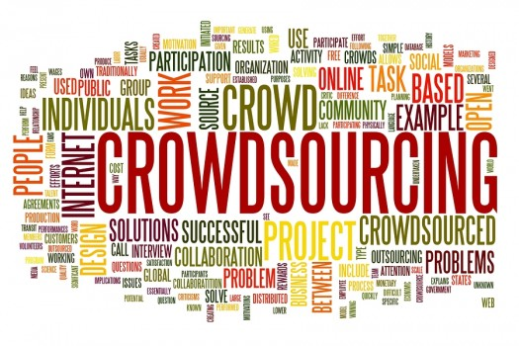

The power of the crowd…
Notes:
Pharmacogenomic (PGx) studies are useful in identifying factors that lead to variation in drug response, which in turn can lead to predictive models for selecting drugs and doses based on genetic information. PGx studies may also guide target validation, an important area, which we feel represents an important product of the network. Today we will speak about both, with an emphasis on the role of Discovery within PGRN:

Slide 7
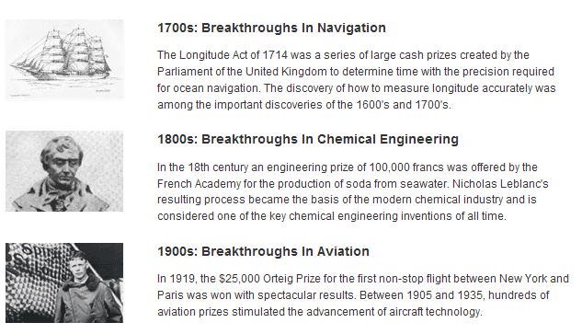
Crowdsourcing is not a new idea…
Notes:
Pharmacogenomic (PGx) studies are useful in identifying factors that lead to variation in drug response, which in turn can lead to predictive models for selecting drugs and doses based on genetic information. PGx studies may also guide target validation, an important area, which we feel represents an important product of the network. Today we will speak about both, with an emphasis on the role of Discovery within PGRN:

Slide 8



Crowdsourcing today is widely used

Slide 9
Benefits of crowdsourcing
Engage large group of participants
  Beyond our immediate collaborators
Open dialogue on methods and results
  Rapid-learning, with insights in real-time
Facilitate peer-review
  Challenge-assisted vs traditional peer-review
Plenge et al Nature Genetics 2013
Notes:
Pharmacogenomic (PGx) studies are useful in identifying factors that lead to variation in drug response, which in turn can lead to predictive models for selecting drugs and doses based on genetic information. PGx studies may also guide target validation, an important area, which we feel represents an important product of the network. Today we will speak about both, with an emphasis on the role of Discovery within PGRN:

Slide 10
How can we effectively use crowdsourcing for PGx traits?

Slide 11
RA Responder Challenge
Define a discrete biological questions
  Polygenic predictor of response to anti-TNF therapy in rheumatoid arthritis
Assemble unique datasets
  Discovery GWAS (n=2,700 RA patients)
  Validation GWAS (n=1,100 RA patients)***
  Additional genomic data (RNA-seq, etc)
Partner with group to host Challenge
  Sage-DREAM
Assemble teams to compete
  Any group with IRB approval!
*** RIKEN application pending
Notes:
Pharmacogenomic (PGx) studies are useful in identifying factors that lead to variation in drug response, which in turn can lead to predictive models for selecting drugs and doses based on genetic information. PGx studies may also guide target validation, an important area, which we feel represents an important product of the network. Today we will speak about both, with an emphasis on the role of Discovery within PGRN:

Slide 12
RA Responder Challenge
Discovery (phase I)
GWAS of treatment response in RA
(n≈2,700 patients)
Polygenic SNP
predictor of response
Genomic data
(e.g., expression profiling)
What is the best SNP-based genetic model to predict response to anti-TNF therapy in RA?
Polygenic modeling project
Eli Stahl
Sarah Pendergrass
Marylyn Ritchie
Jing Cui
Notes:
Pharmacogenomic (PGx) studies are useful in identifying factors that lead to variation in drug response, which in turn can lead to predictive models for selecting drugs and doses based on genetic information. PGx studies may also guide target validation, an important area, which we feel represents an important product of the network. Today we will speak about both, with an emphasis on the role of Discovery within PGRN:

Slide 13
RA Responder Challenge
Discovery (phase I)
GWAS of treatment response in RA
(n≈2,700 patients)
Polygenic SNP
predictor of response
Genomic data
(e.g., expression profiling)
*** An outcome of the PGRN polygenic modeling network-wide project
Notes:
Pharmacogenomic (PGx) studies are useful in identifying factors that lead to variation in drug response, which in turn can lead to predictive models for selecting drugs and doses based on genetic information. PGx studies may also guide target validation, an important area, which we feel represents an important product of the network. Today we will speak about both, with an emphasis on the role of Discovery within PGRN:

Slide 14
RA Responder Challenge
Discovery (phase I)
GWAS of treatment response in RA
(n≈2,700 patients)
Polygenic SNP
predictor of response
Refine model
Genomic data
(e.g., expression profiling)
Open Collaboration
Build models as a community, sharing insights in real-time
Peer insights
1)
2)
etc.
synapse
Sage Bionetworks
Lara Mangravite
Jonathan Derry
Stephen Friend
Notes:
Pharmacogenomic (PGx) studies are useful in identifying factors that lead to variation in drug response, which in turn can lead to predictive models for selecting drugs and doses based on genetic information. PGx studies may also guide target validation, an important area, which we feel represents an important product of the network. Today we will speak about both, with an emphasis on the role of Discovery within PGRN:

Slide 15
RA Responder Challenge
Discovery (phase I)
GWAS of treatment response in RA
(n≈2,700 patients)
Validation (phase II)
Polygenic SNP
predictor of response
Submit models
GWAS of treatment response in RA
(n≈1,100 patients)
Refine model
Genomic data
(e.g., expression profiling)
Open Collaboration
Score models
Peer insights
1)
2)
etc.
synapse
Test models in an independent dataset (CORRONA)
CORRONA
Jeff Greenberg
Dimitrios Pappas
Joel Kremer
Notes:
Pharmacogenomic (PGx) studies are useful in identifying factors that lead to variation in drug response, which in turn can lead to predictive models for selecting drugs and doses based on genetic information. PGx studies may also guide target validation, an important area, which we feel represents an important product of the network. Today we will speak about both, with an emphasis on the role of Discovery within PGRN:

Slide 16
RA Responder Challenge
Discovery (phase I)
GWAS of treatment response in RA
(n≈2,700 patients)
Validation (phase II)
Polygenic SNP
predictor of response
Submit models
GWAS of treatment response in RA
(n≈1,100 patients)
Refine model
Genomic data
(e.g., expression profiling)
Open Collaboration
Score models
responses
Peer insights
1)
2)
etc.
synapse
Publication
Publish with Nature Genetics
Peer-review
Challenge-assisted peer review
Publication peer review
Notes:
Pharmacogenomic (PGx) studies are useful in identifying factors that lead to variation in drug response, which in turn can lead to predictive models for selecting drugs and doses based on genetic information. PGx studies may also guide target validation, an important area, which we feel represents an important product of the network. Today we will speak about both, with an emphasis on the role of Discovery within PGRN:

Slide 17
Notes:
Pharmacogenomic (PGx) studies are useful in identifying factors that lead to variation in drug response, which in turn can lead to predictive models for selecting drugs and doses based on genetic information. PGx studies may also guide target validation, an important area, which we feel represents an important product of the network. Today we will speak about both, with an emphasis on the role of Discovery within PGRN:

Slide 18
Unresolved questions of our crowdsourcing approach
Scientific
  What is the power to detect polygenic signal?
  How much will genomic datasets add?
  Is a SNP-based approach the best?
Social
  Will groups collaborate or compete?
  Is the Synapse platform sufficient to communicate among diverse groups?
Practical
  How will we manage data access?
Notes:
Pharmacogenomic (PGx) studies are useful in identifying factors that lead to variation in drug response, which in turn can lead to predictive models for selecting drugs and doses based on genetic information. PGx studies may also guide target validation, an important area, which we feel represents an important product of the network. Today we will speak about both, with an emphasis on the role of Discovery within PGRN:

Slide 19
Initial surprises from putting the Challenge together
Industry sponsorship
  Several companies have promised support to host the Challenge
  Initial conversations to generate more data
Foundation sponorship
  Arthritis Foundation has supported the Challenge, given next-gen approach and “citizen-scientist” emphasis
Sharing among colleagues
  no issues sharing data…actually more!
Notes:
Pharmacogenomic (PGx) studies are useful in identifying factors that lead to variation in drug response, which in turn can lead to predictive models for selecting drugs and doses based on genetic information. PGx studies may also guide target validation, an important area, which we feel represents an important product of the network. Today we will speak about both, with an emphasis on the role of Discovery within PGRN:

Slide 20
This is meant to be the first step
RNA-predictors of response
Internet registry “citizen-scientist” clinical trial
NIH academic-industry “target validation consortium”
  “disease deconstruction”
Notes:
Pharmacogenomic (PGx) studies are useful in identifying factors that lead to variation in drug response, which in turn can lead to predictive models for selecting drugs and doses based on genetic information. PGx studies may also guide target validation, an important area, which we feel represents an important product of the network. Today we will speak about both, with an emphasis on the role of Discovery within PGRN:

Slide 21
Sage-DREAM collaboration
Breast Cancer Challenge
  Published in Science Translational Medicine
Glioblastoma Challenge
Other Challenges planned for 2013
  See sagebase.org for list of Challeges
Notes:
Pharmacogenomic (PGx) studies are useful in identifying factors that lead to variation in drug response, which in turn can lead to predictive models for selecting drugs and doses based on genetic information. PGx studies may also guide target validation, an important area, which we feel represents an important product of the network. Today we will speak about both, with an emphasis on the role of Discovery within PGRN:

Slide 22
Is crowdsourcing attractive to other PGRN investigators?

