Slide 1
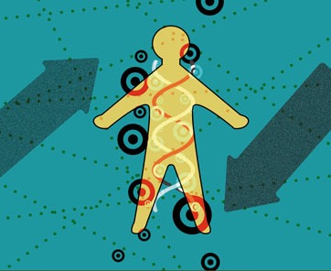
New Targets, New Modalities, New Challenges – The Inconvenient Path of Human Genetics in Drug Discovery
Enabling Precision Medicine: The Role of Genetics in Clinical Drug Development – A Workshop
March 8, 2017

Slide 2
Overall message
precision medicine: patient subsets for whom therapeutic intervention works better
few approved drugs will benefit from precision medicine
greatest impact will be to guide new drug development, which will be tested and approved in patient subsets
However, this path is inconvenient, and will require biological insight into targets, new therapeutic modalities, and a more creative approaches to clinical development

Slide 3
Cost
Value

Slide 4
Must improve efficiency of drug R&D
Cost
Value

Slide 6
Why is cost increasing?
Too many Phase 2/3 studies fail
Time between discovery and PoC is too long

Slide 7
Why don’t drugs differentiate?
Not enough sound therapeutic hypotheses!

Slide 8
How will precision medicine help?
Improve cycle time from therapeutic hypothesis to clinical PoC…efficiently and safely

Slide 9
Today: 5-7 years

Slide 10
<1 yr

Slide 11
What are potential solutions?
Pick targets based on human biology
Programmable therapeutics to test PoC

Slide 12
human genetics to pick targets

Slide 13
Pick a human phenotype for drug efficacy
High
Human Phenotype
Low
GOF
LOF
Gene function
Plenge et al NRDD 2013

Slide 14
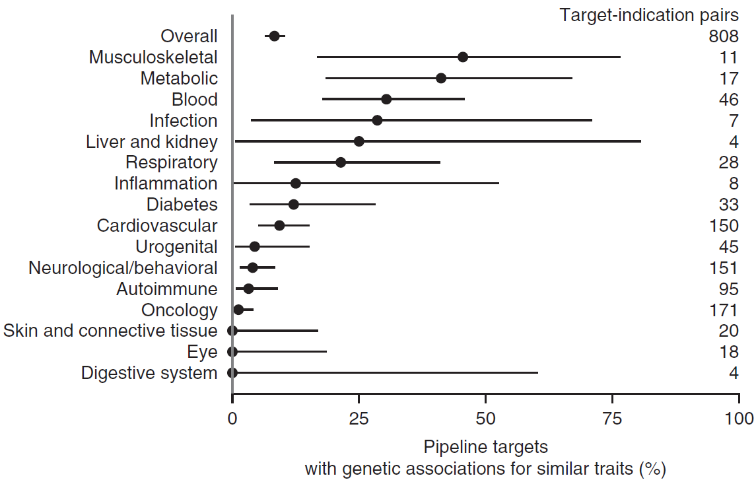
Pick a human phenotype for drug efficacy
High
Human Phenotype
Low
GOF
LOF
Gene function
Nelson et al NG 2015

Slide 15
Pick a human phenotype for drug efficacy
X
High
X
Identify a series of alleles with range of effect sizes in humans (but of unknown function)
X
Human Phenotype
X
X
X
X
Low
GOF
LOF
Gene function

Slide 16
Pick a human phenotype for drug efficacy
High
Human Phenotype
Low
GOF
LOF
>100 rare variants
6 common variants
Gene function
Khera et al JAMA 2017

Slide 17
Pick a human phenotype for drug efficacy
Efficacy
X
High
X
Assess biological function of alleles to estimate “efficacy” response curve
X
Human Phenotype
X
X
X
X
Low
GOF
LOF
Gene function

Slide 18
New target for drug screen!
Pick a human phenotype for drug efficacy
Efficacy
X
X
Toxicity
High
Assess biological function of alleles to estimate “efficacy” response curve
X
Assess pleiotropy as proxy for ADEs
Human Phenotype
X
X
X
This provides evidence for the therapeutic window at the time of target ID & validation.
X
Low
GOF
LOF
Gene function

Slide 19
programmable therapeutics to test therapeutic hypotheses quickly

Slide 20
Today: 5-7 years

Slide 21
<1 yr

Slide 22
Limitations that we face today
Biological function of associated variants, genes & pathways incompletely understood
Conventional modalities (e.g., small molecules, monoclonal antibodies) modulate <20% of targets
New modalities are desperately needed, but today are limited by delivery and pharmacological properties

Slide 23
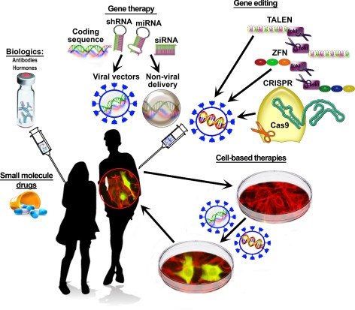
Other
mRNA replacement
protein degradation
RBC as vehicles

Slide 24
Burning platform for precision medicine
understand molecular mechanism of disease-associated variants, genes and pathways
recapitulate mechanism with a credible therapeutic molecule
shorten cycle time to test therapeutic hypotheses in small PoC trials defined by specific molecular features

Slide 25
Conclusion

Slide 26
Overall message - inconvenient path to precision medicine
precision medicine: patient subsets for whom therapeutic intervention works better
few approved drugs will benefit from precision medicine
greatest impact will be to guide new drug development, which will be tested and approved in patient subsets
However, this path is inconvenient, and will require biological insight into targets, new therapeutic modalities, and a more creative approaches to clinical development

