Slide 1


Notes:
The world's geographic frontiers were opened centuries ago by small groups of explorers, but today 500 000 Finns begin a major expedition to the frontier of genomics and medicine.

Slide 2
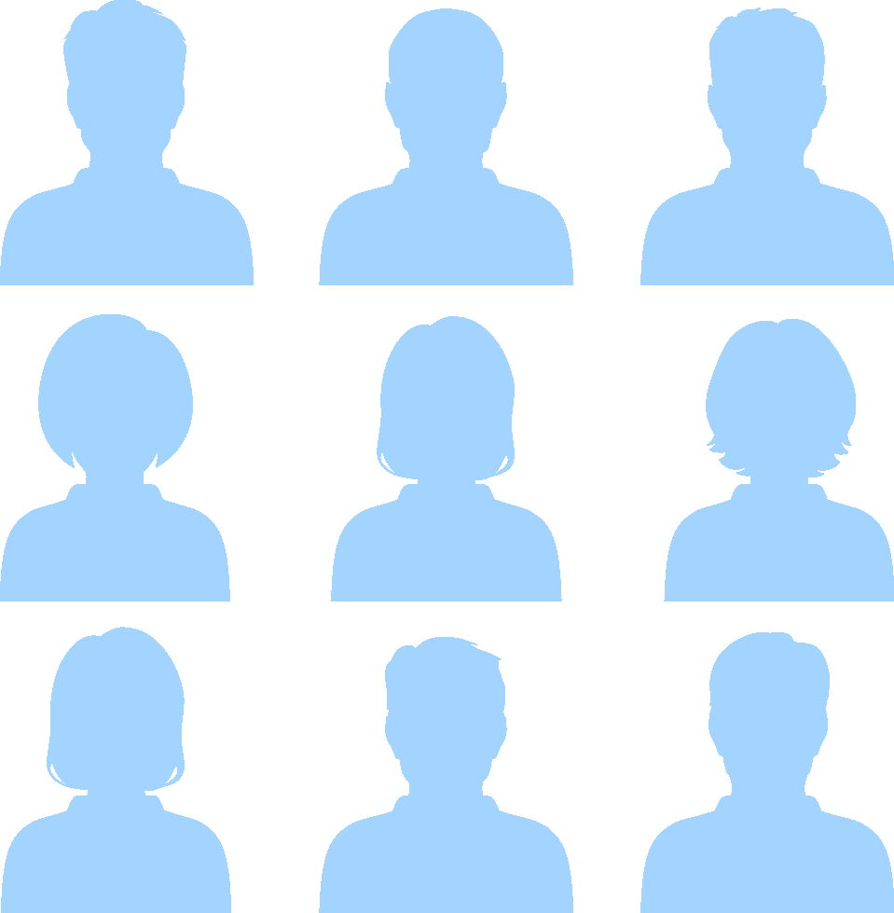
So far people have been treated based on their diagnosis…
I63.9
M06.9
M06.9
Notes:
The FinnGen research project will take people on a journey to explore future health innovations. We can find the next breakthroughs in disease prevention, diagnosis and treatment.

Slide 3
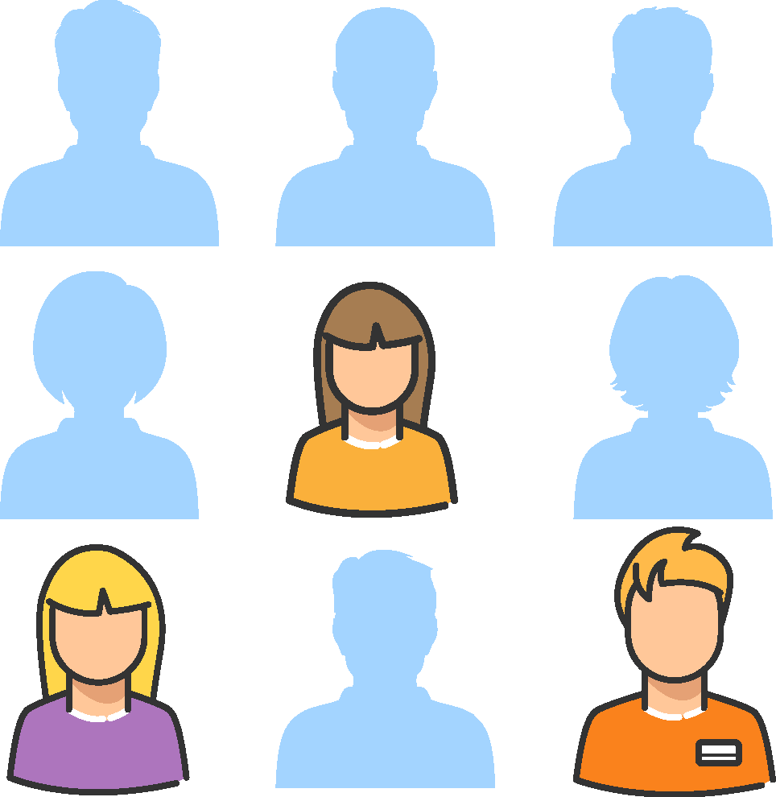
…but soon diseases will be treated based on people and their genomes.
Notes:
Covering all of Finland, the FinnGen research project is a collective study by all Finns. Its most significant findings can be found on anybody’s biobank sample and help people around the world.

Slide 4
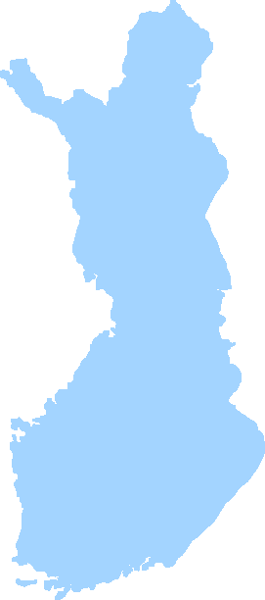
1O % of the population =
500,000 Finns
Notes:
FinnGen is one of the very first personalized medicine projects at this scale. The aim of the six-year FinnGen research is to involve 500,000 Finns. Every Finn can be part of the research by giving consent to deposit his / her own sample into a biobank.

Slide 5
1O % of the population
Existing sample collections:
215 000 Finns
285 000 new sample donors within the upcoming 6 years

Slide 6


Sometimes the solutions to individuals' illnesses can be found by looking at big masses, even entire nations.
Notes:
When the journey begins, its future findings cannot yet be fully known. FinnGen aims to enhance the current understanding of diseases and their prevention and to identify potential drug targets. Sometimes solutions to individuals' illnesses can be found by looking at large masses, even entire nations.

Slide 7
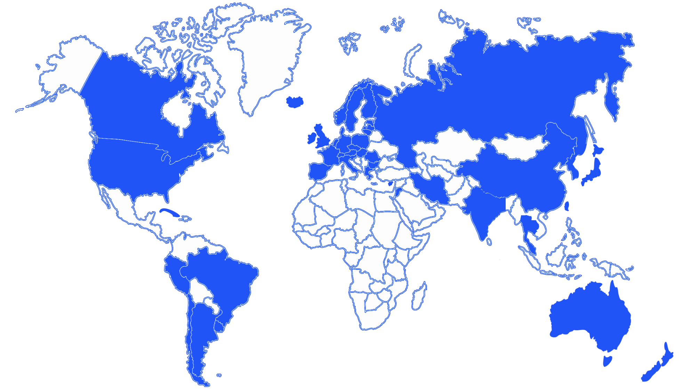
Why Finland?
  Countries with Biobanks
  Universal Healthcare
  Unique personal identity code
  Isolated population
  Recalling made easy
  (biobank act + social security number)
  X
Notes:
Finland has exceptional conditions for a genetic research covering the whole population. Finland has an internationally unique biobank act that makes collections of hospitals and research institutes available for all researchers. Combined with the other strengths of Finland: comprehensive registers, electronic medical records and a research-friendly population, it enables extraordinary opportunities for new research and business. Moreover, thanks to the genetically unique Finns, genomics data is faster to analyze and the probability of findings is higher than in genetically heterogenic populations.
Background information
Countries with Biobank:
Europe: Austria, Belgium, Bulgaria, Czech Republic, Cyprus, Denmark, Estonia, Finland, France, Germany, Greece, Hungary, Iceland, Italy, Ireland, Latvia, Lithuania, Luxembourg, Malta, Netherlands, Norway, Poland, Portugal, Romania, Slovakia, Spain, Sweden, Switzerland, UK
Asia: China, India, Japan, Korea, Malesia, Singapore, Taiwan, Thailand
Afrikka: Gambia, Uganda, South-Africa,
Middle east: Iran, Israel, Jordan, Kuwait, Qatar, UAE
Others: Australia, Canada, USA, New Zealand, Russia
Latin America: LACTumorbank Network (governmental cancer institutions): Argentina, Brasil, Chile, Columbia, Cuba, Equador, Mexico, Panama, Peru, Uruguay, Venezuela
Biobanks can be established within academic medical or research institutions, pharmaceutical/biotechnology companies or as stand-alone organizations.
Types of Biobanks: Population based biobanks for genetic research and clinical/disease-orientated biobanks that collect biological samples from patients, aiming at discovery and validation of genetic and non-genetic risk factors of diseases.
Sources:
http://specimencentral.com/biobank-directory/
http://bbmri-eric.eu/memberstates
http://www.nature.com/gim/journal/v9/n3/full/gim200726a.html
http://www.esbb.org/biobanks.html
http://ftp.jrc.es/EURdoc/JRC57831.pdf
About Biobanks: https://www.google.fi/url?sa=t&rct=j&q=&esrc=s&source=web&cd=1&ved=0ahUKEwiTt_3OnLjJAhUK2SwKHffLDsAQFggfMAA&url=http%3A%2F%2Fwww.springer.com%2Fcda%2Fcontent%2Fdocument%2Fcda_downloaddocument%2F9789401795722-c2.pdf%3FSGWID%3D0-0-45-1493350-p177035425&usg=AFQjCNE0teYnvHY6qgVa4WpreuUbHXtzfA
LATIN AMERICA:
LACTumorBank Network: governmental cancer institutions: Kolumbia, Cuba, Mexico, Peru, Equador, Argentina, Uruguay, Chile, Panama, Venezuela, Brazil
http://bvsms.saude.gov.br/bvs/publicacoes/inca/Claudio_Gustavo_Stenaff_Latin_America_and_Caribbean.pdf
MALTA
http://www.um.edu.mt/biobank
NEW ZEALAND
http://ir.canterbury.ac.nz/handle/10092/2594
https://www.fmhs.auckland.ac.nz/en/faculty/cbr/our-centre/biobank.html
AFRICA: Uganda, Cape Town
http://www.b3africa.org

Slide 8
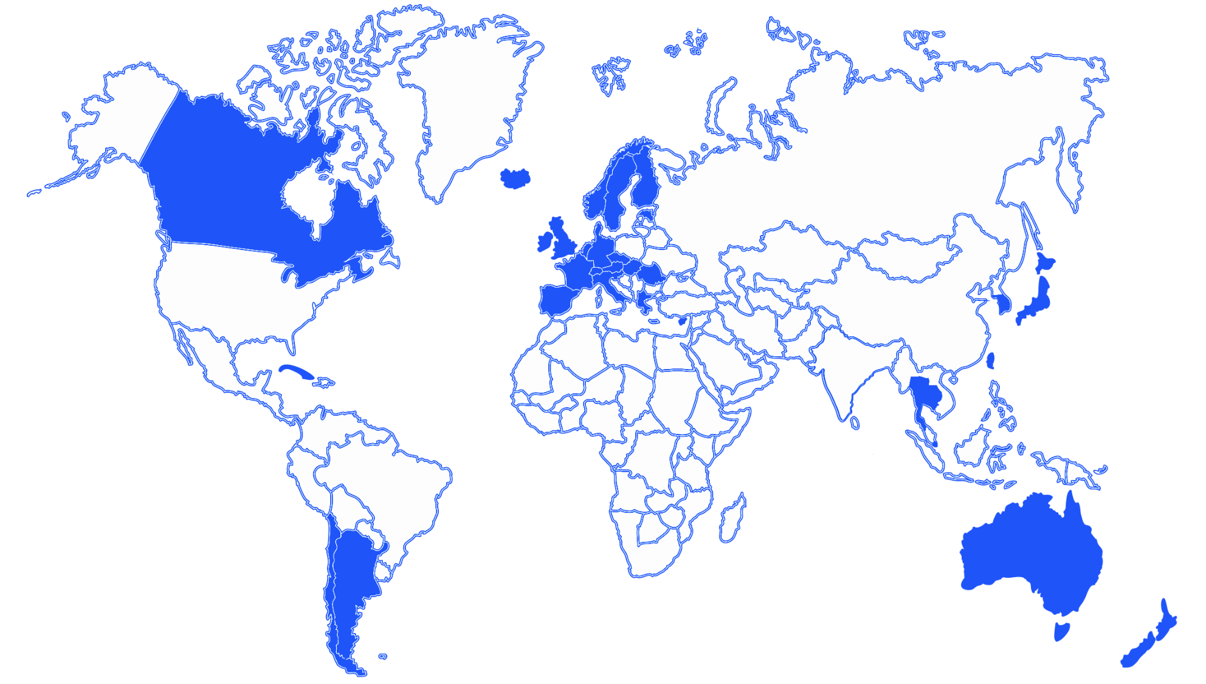
Why Finland?
  Countries with Biobanks
  Universal Healthcare
  Unique personal identity code
  Isolated population
  Recalling made easy
  (biobank act + social security number)
  X
  X
Notes:
Background data
Countries with Biobank + Universal Healthcare
Europe: Austria, Belgium, Czech Republic, Cyprus, Denmark, Estonia, Finland, France, Germany, Greece, Hungary, Iceland, Italy, Ireland, Luxembourg, Netherlands, Norway, Portugal, Romania, Slovakia, Spain, Sweden, Switzerland, UK
Asia: Japan, South Korea, Singapore, Taiwan, Thailand
Middle east: Israel, Kuwait, UAE
Others: Australia, Canada, New Zealand
Latin America: LACTumorbank Network (governmental cancer institutions): Argentina, Chile, Cuba, Panama, Venezuela
Source: 58 countries with universal health care in 2009, according to Stuckler, et al.^{[1]}
Stuckler, David; Feigl, Andrea B.; Basu, Sanjay; McKee, Martin (November 2010). "The political economy of universal health coverage. Background paper for the First Global Symposium on Health Systems Research, 16–19 November 2010, Montreaux, Switzerland" (PDF). Pacific Health Summit. Seattle: National Bureau of Asian Research. p. 16. “Figure 2. Global Prevalence of Universal Health Care in 2009; 58 countries: Andorra, Antigua, Argentina, Armenia, Australia, Austria, Azerbaijan, Bahrain, Belarus, Belgium, Bosnia and Herzegovina, Botswana, Brunei Darussalam, Bulgaria, Canada, Chile, Costa Rica, Croatia, Cuba, Cyprus, Czech Republic, Denmark, Estonia, Finland, France, Germany, Greece, Hungary, Iceland, Ireland, Israel, Italy, Japan, Kuwait, Luxembourg, Moldova, Mongolia, Netherlands, New Zealand, Norway, Oman, Panama, Portugal, Romania, Singapore, Slovakia, Slovenia, South Korea, Spain, Sweden, Switzerland, Taiwan, Thailand, Tunisia, UAE, Ukraine, United Kingdom, Venezuela.”
http://www.theatlantic.com/international/archive/2012/06/heres-a-map-of-the-countries-that-provide-universal-health-care-americas-still-not-on-it/259153/
https://en.wikipedia.org/wiki/Universal_health_care
https://en.wikipedia.org/wiki/Universal_health_care#/media/File:Universal_health_care.svg

Slide 9
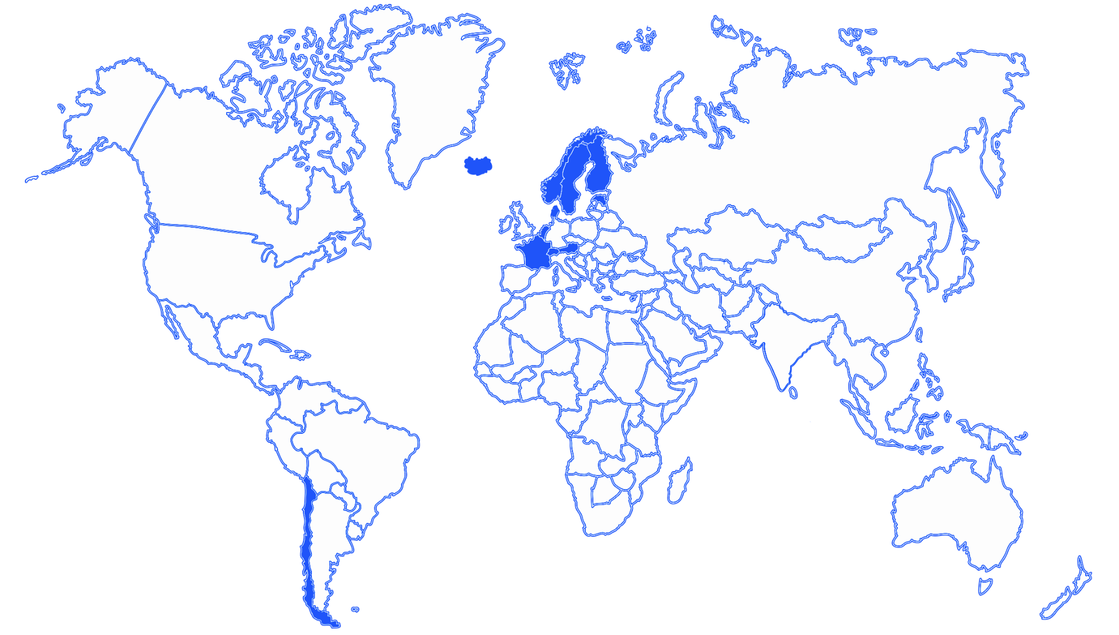
Why Finland?
  Countries with Biobanks
  Universal Healthcare
  Unique personal identity code
  Isolated population
  Recalling made easy
  (biobank act + social security number)
  X
  X
  X
Notes:
Background data
Countries with Biobank + Universal healthcare + National Identification Number
Europe: Austria, Belgium, Denmark, Estonia, Finland, France, Iceland, Netherlands, Norway, Sweden, Switzerland, UK
Latin America: LACTumorbank Network (governmental cancer institutions): Chile
Unique personal identity code
Similar personal identity code system was deployed at the same time in other Nordic countries. The structure of the identity code is similar even tough some details differ.
Source: https://fi.wikipedia.org/wiki/Henkilötunnus
Similar indentity code is used in Sweden (personnummer), Norway (fødselsnummer), Denmark (personnummer or CPR-nummer), Iceland (kennitala), Estonia (isikukood), Netherlands (burgerservicenummer), Belgium (rijksregisternummer), France (code INSEE), Austria (Sozialversicherungsnummer), Switzerland (AHV-Nummer), Lithuania (asmens kodas) ja Chile (Rol Único Nacional tai RUN).
USA has a very similar system (social security number, SSN), even though it wasn’t created for the same purposes. SSN is not given to people when they’re born so it is possible to live in the USA without SSN but it will make taking care of practical things more challenging.
How to decode the Finnish personal identity code:
http://www.tuomas.salste.net/doc/hetu/tunnus.html
Background of Finnish personal identity code:
Every Finn has a personal identity code, which is an 11 digit character string. It consists of birth date, individual number, check digit and sex.

Slide 10
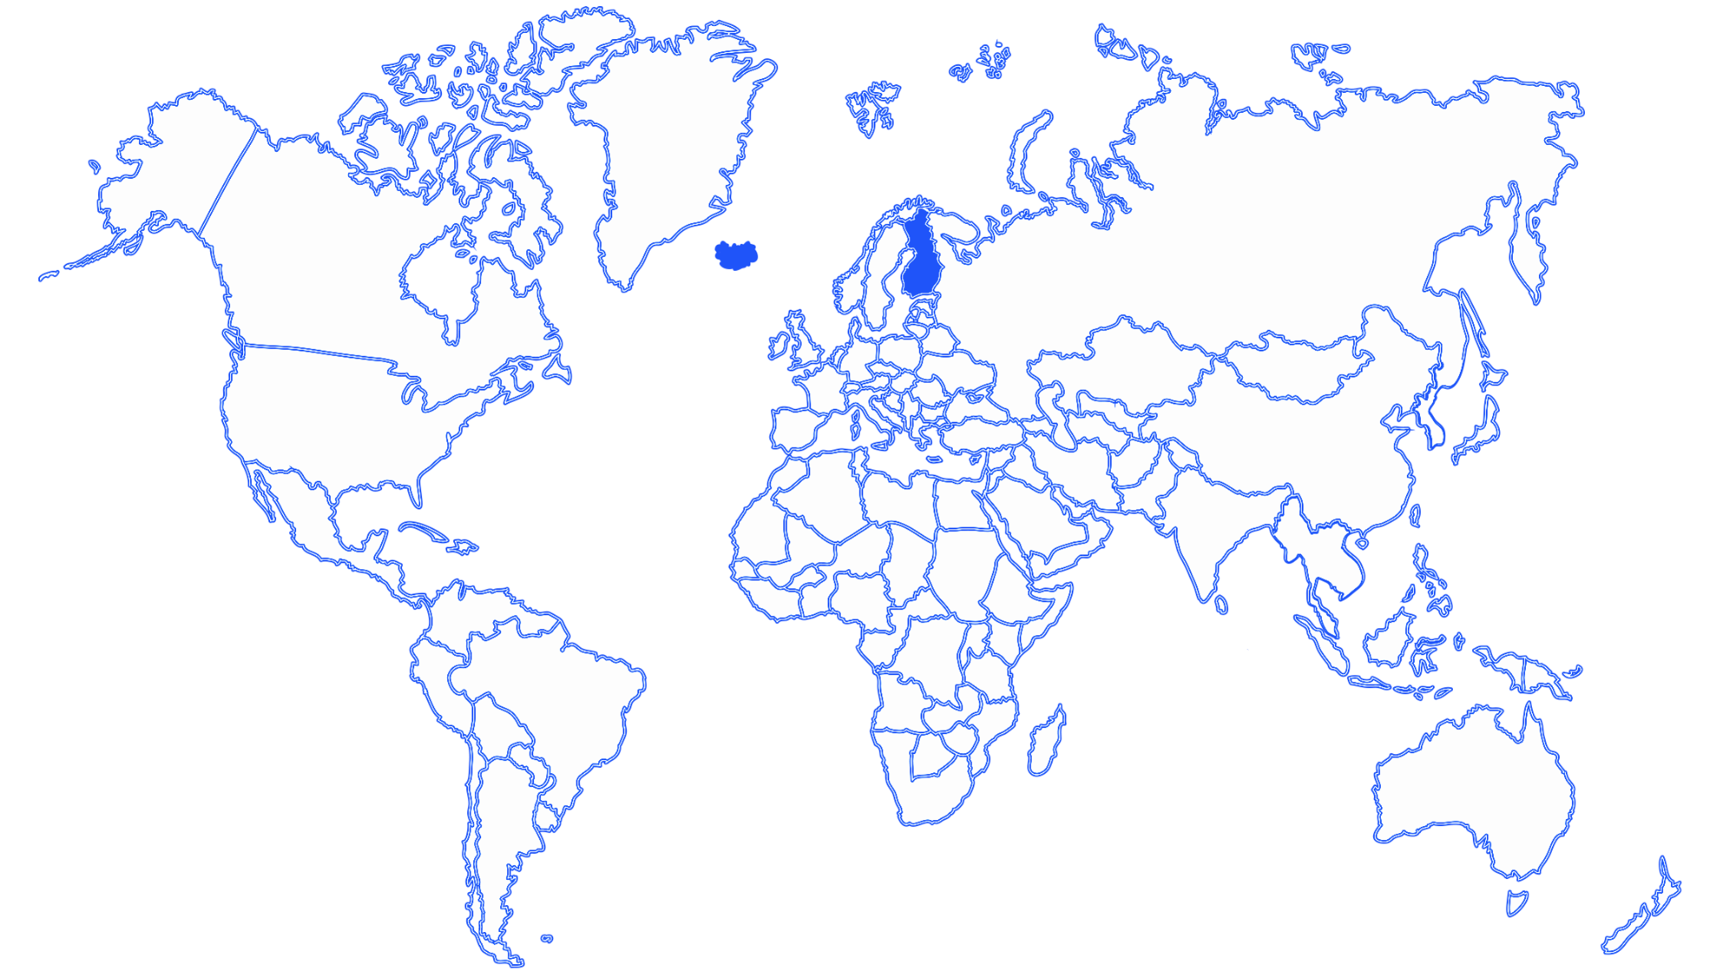
Why Finland?
  Countries with Biobanks
  Universal Healthcare
  Unique personal identity code
  Isolated population
  Recalling made easy
  (biobank act + social security number)
  X
  X
  X
  X
Notes:
Background information
Countries with Biobank + Universal healthcare + national identification number + genetically isolated population
Eurooppa: Finland, Iceland
Source: http://hmg.oxfordjournals.org/content/11/20/2507.full
The struggle to identify susceptibility genes for complex disorders has stimulated geneticists to develop new approaches. One approach that has gained considerable interest is to focus on genetically isolated populations rather than on the general population.
In general, the statistical power to detect a real association or linkage is limited by the background noise in the population under study. This noise consists of all possible combinations of environmental and genetic factors present in the population. Therefore, in heterogeneous populations, large sample sizes would be needed to obtain sufficient statistical power to detect genetic risk factors. More homogeneous populations such as genetically isolated populations have been proposed as a possible alternative for these large sample sizes, because environmental variation might be lower and the genetic make-up of these populations is expected to be less complex owing to founder effects, thus improving the signal-to-noise ratio. The use of genetically isolated populations is not new; for example, in Finland, there are numerous examples of Mendelian disorders with increased prevalence (29). This has been especially valuable for mapping rare recessive disorders. but many researchers believe this could be a solution for more complex disorders as well because of the relatively uniform genetic background of the population. Some culturally and genetically isolated populations have a more similar way of living, eating habits and natural environment that reduces environmental variation. Often these populations have been founded by a small number of individuals, followed by a period of genetic isolation, during which genetic drift might have been seen and population expansion mainly occurred by population growth and not by immigration. In addition, if genealogical records are available, the kinship coefficient of patients can be determined, which is often higher than in heterogeneous populations. In countries from Scandinavia, for example, state healthcare registries have been maintained over centuries

Slide 11
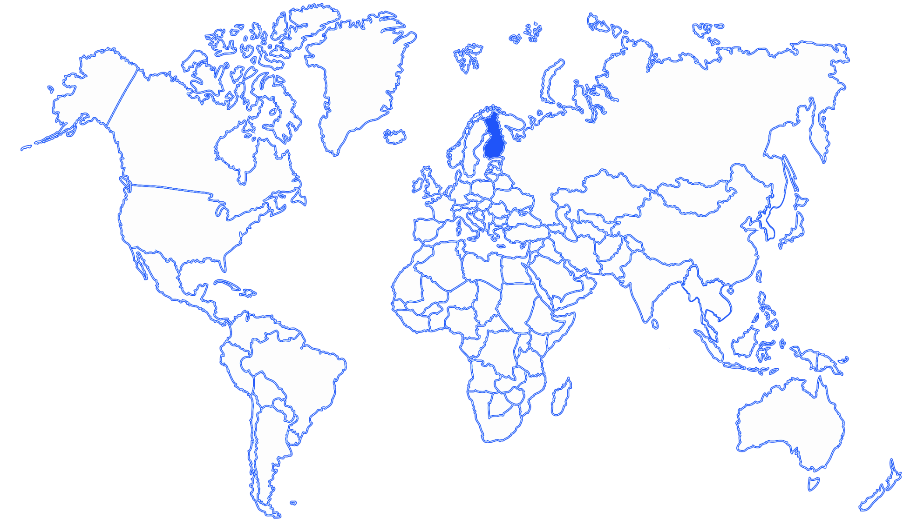
Why Finland?
  Countries with Biobanks
  Universal Healthcare
  Unique personal identity code
  Isolated population
  Recalling made easy
  (biobank act + social security number)
  X
  X
  X
  X
  X
Notes:
Recalling option made easy by biobank act + national identification number

Slide 12
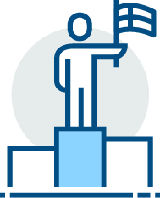
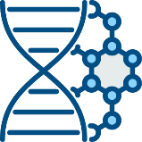
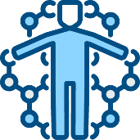
Why Finland?
Unique genetic ancestry
Biobanks
Comprehensive high-quality
health care system
Highly educated experts
FINLAND
National health registers
Government support
TRANSFORMATION OF
PHARMACEUTICALS
PERSONALIZED
MEDICINE
Notes:
The long-established public health care system together with a transitioning medicine industry has attracted an exceptionally large research investment into Finland. Traditionally, Finland has not been a leader in drug development and research but now for the first time Finland is at the forefront of the field. Development of personalized treatments is about to transform healthcare globally, and we continue to learn about the possibilities it can bring.

Slide 13


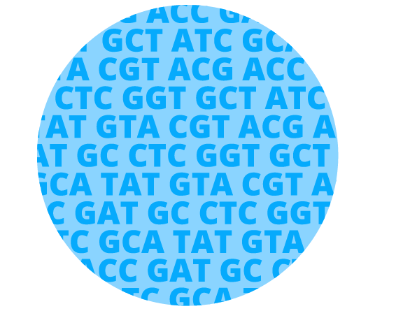

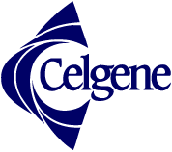


Collaboration
PUBLIC
HEALTHCARE
PHARMA-
CEUTICAL
COMPANIES
Notes:
Traditionally pharmaceutical companies haven't done mutual R&D but are joining forces for a common goal: it is in everyone's interest to utilize genetic information and to combine it with healthcare data. Smaller projects that predate FinnGen have produced promising results on the possibilities of human genome data combined with healthcare. However, much remains to be learned and as no pharmaceutical company alone has sufficient resources to undertake this research, it is vital to combine forces for a joint research process. The success lies in the cooperation of public and private sectors.

Slide 14
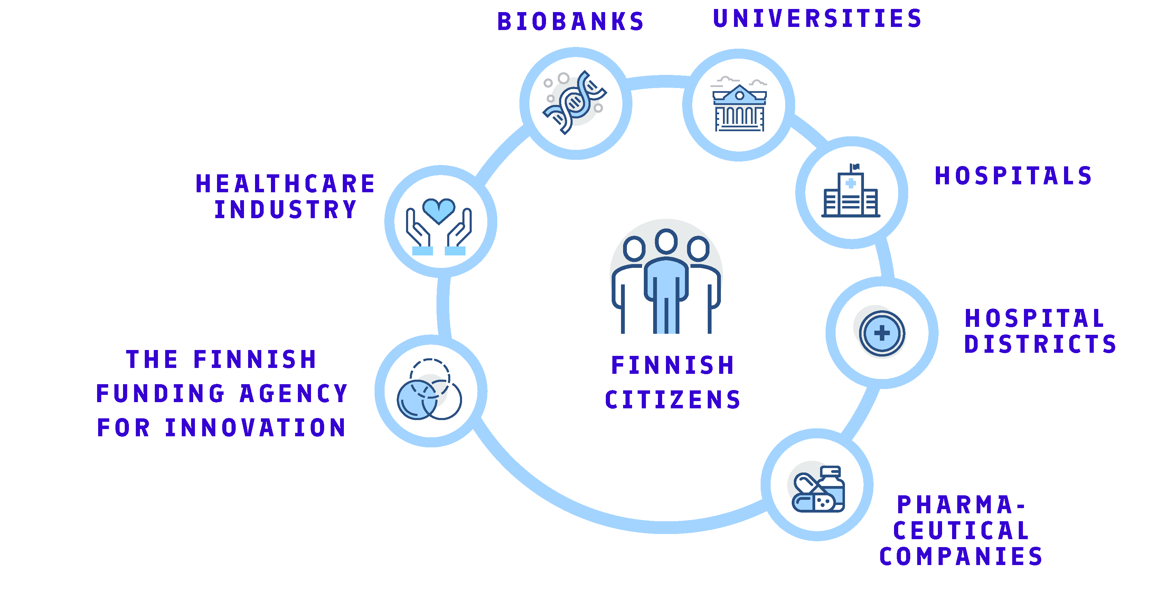
Partners
Notes:
The FinnGen project provides exceptionally wide and open co-operation involving biobanks, universities, hospital districts, healthcare industry and hopefully all Finns. The project is coordinated by researchers from the University of Helsinki and the hospital district of Helsinki and Uusimaa.

Slide 15

Funding
TEKES 20 M€
PHARMACEUTICAL INDUSTRY 39 M€
(7 GLOBAL COMPANIES)
59M€
HOSPITAL DISTRICTS AND THL DONATE DOZENS OF MAN-YEARS OF LABOR INPUT BY COLLECTING SAMPLES
THE INPUT OF FINNISH UNIVERSITIES AND THL
THE INPUT OF FINNISH COMPANIES
Notes:
Total funding for the research project is € 59M and all parties involved in the research funding are invested with different inputs. Tekes and the pharmaceutical industry support the research financially, and hospital districts invest dozens of man-years by collecting samples and informing citizens of the research project.

Slide 16
Goals of FinnGen
01
03
PRODUCE MEDICAL INNOVATIONS BY COMBINING HEALTH REGISTRY AND GENOME DATA
CREATE A CO-OPERATION MODEL BETWEEN PUBLIC SECTOR AND HEALTHCARE INDUSTRY
02
04
SUPPORT FINLAND TO BECOME A PIONEER BIOMEDICINE AND PERSONALIZED HEALTHCARE
PROVIDE EARLY ACCESS TO NEW PERSONALIZED TREATMENTS AND HEALTH INNOVATIONS FOR ALL FINNS
Notes:
Although the findings of the journey are still unknown, the enriched data analyzed in the FinnGen study is an investment in our collective future. With this study, we will have a more detailed manual for the human body. We will gain a better understanding of how our genome affects our health and what is the effect of environment and our lifestyles. With FinnGen research data Finland is taking a big leap forward in growing excellence in biomedicine.

Slide 17
Benefits
Pharma
Citizens
New, more reliable solutions for healthcare, disease prediction and prevention
Unique co-operation with new kind of partners. Access to valuable genotypic and phenotypic data from the Finnish population, possibility to identify new potential drug targets.
Biobanks
Research
Expanding the sample collections and enriching the value of the samples with genomic data. Highlighting the excellence of Finnish biomedical research.
The data generated will remain in Finland and can be used for future research purposes increasing the attractiveness of Finland as a partner.
Competitiveness for Finland
Notes:
The FinnGen research project benefits citizens, businesses, biobanks and research - and ultimately the entire world. After the completion of the project, genome information produced during the study will be returned to the Finnish biobanks and made available to researchers and companies.

Slide 18
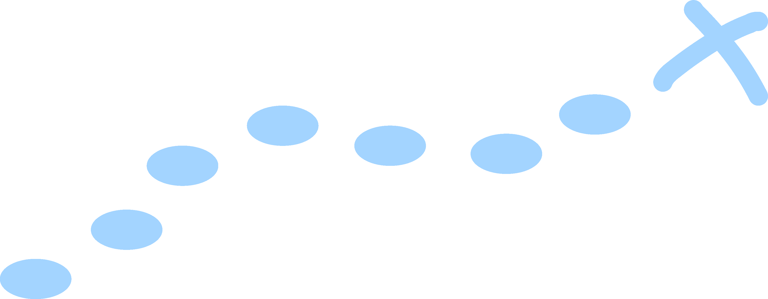
Journey Plan
5)
A part of the DNA-sample is sent first to sample logistics laboratory and then to a subcontractor
1)
A citizen gives a biobank consent
2)
The sample is stored into a biobank
3)
The blood sample is processed into DNA
4)
One of the biobanks applies for the health register data
6)
Subcontractor performs genomic analysis and sends the encrypted data back
7)
Combining genome and health register data
8)
Scientific analysis
9)
Genome data is transferred to the biobank
Notes:
FinnGen research project and the flow of information have been prepared for many years, as the prerequisite for successful expeditions is careful planning.
1) A citizen gives a biobank consent. It can be withdrawn at any time and the sample donor can request information about the use of the sample.
2) The sample is stored in to a biobank.
3) The blood sample is processed into DNA
4) One of biobanks applies for the health register data
5) A small part of the sample is sent to a sample logistics laboratory where the samples are prepared for genotyping and sent to a subcontractor
6) Subcontractor performs genomic analysis and sends the encrypted data back
7) Genome data and data from the national health registers are combined on the basis of the sample identifier.
8) Scientific analysis
9) Genome data is transferred to the biobank

Slide 19
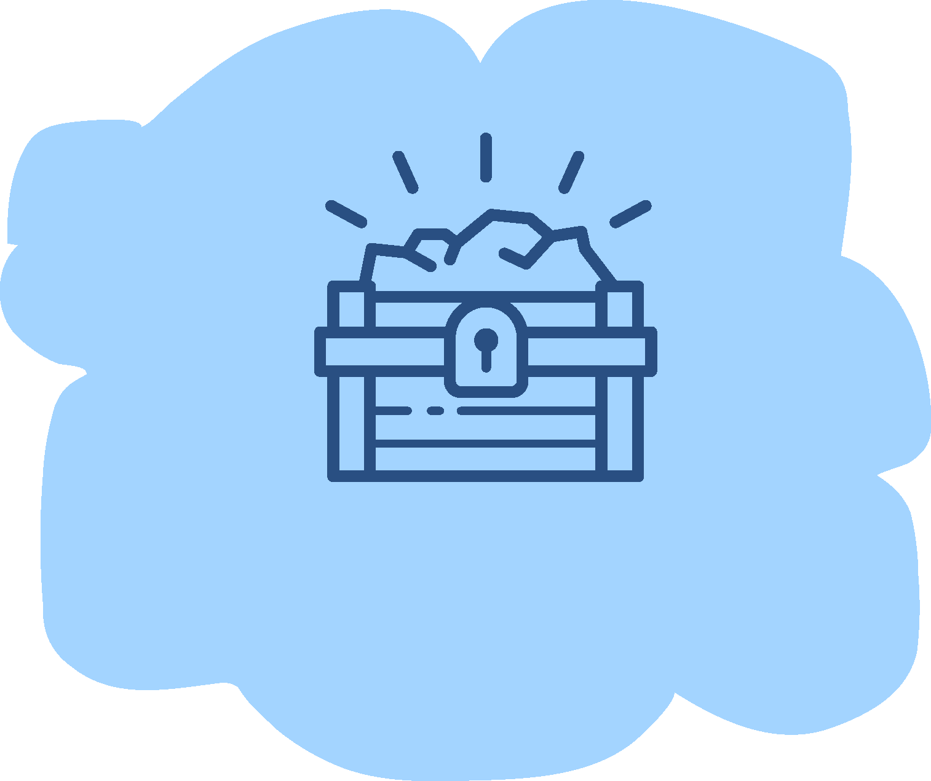
Journey Plan
FINNGEN RESEARCH DATA
The findings are utilized in the research project and the genomic data stored to biobank
Notes:
Finally, FinnGen research data is analysed. The analysis team includes top experts from participating organizations, ie universities, biobanks, hospitals and businesses. The findings are utilized in the research project and the genomic data stored to biobank.

Slide 20
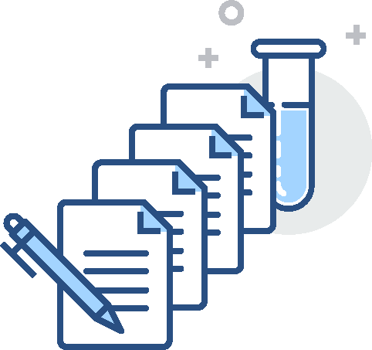
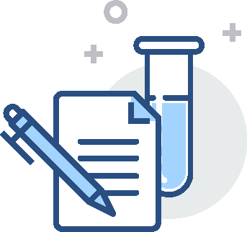
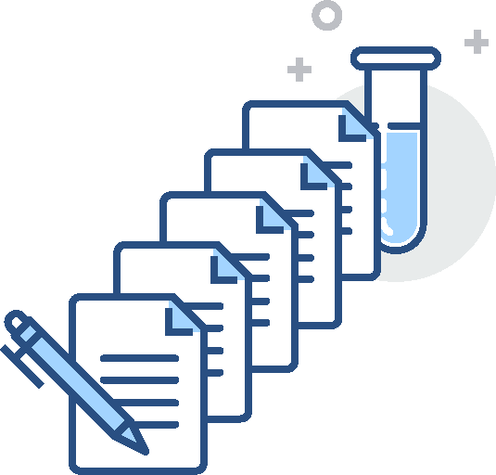
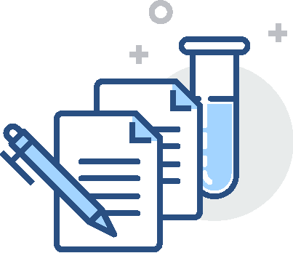
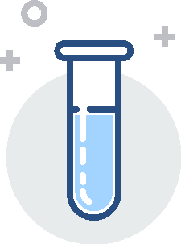
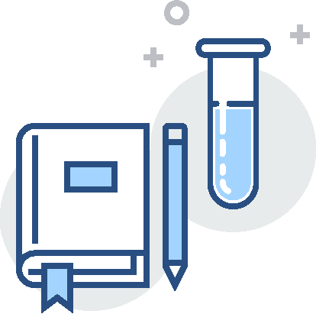
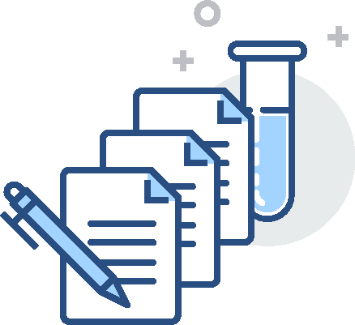
Enriching the sample
SAMPLE
Notes:
Enriching the sample creates opportunities to see causalities and make discoveries that help to develop new solutions. Enriching means combining data from national health registers with analyzed genomic and sequence data. All the samples are encoded, and the FinnGen analysis team will not know at any time whose samples are included in the study.

Slide 21
Enriching the sample
SAMPLE
HOSPITAL REGISTER DATA

Slide 22
Enriching the sample
SAMPLE
HOSPITAL REGISTER DATA
DISEASE REGISTERS

Slide 23
Enriching the sample
SAMPLE
HOSPITAL REGISTER DATA
DISEASE REGISTERS
BIRTH AND CIVIL REGISTERS

Slide 24
Enriching the sample
SAMPLE
HOSPITAL REGISTER DATA
DISEASE REGISTERS
PRESCRIPTION REGISTERS
BIRTH AND CIVIL REGISTERS

Slide 25
Enriching the sample
SAMPLE
HOSPITAL REGISTER DATA
CANCER AND INFRINGEMENT REGISTERS
DISEASE REGISTERS
PRESCRIPTION REGISTERS
BIRTH AND CIVIL REGISTERS

Slide 26
Enriching the sample
SAMPLE
CAUSE OF DEATH REGISTER
HOSPITAL REGISTER DATA
CANCER AND INFRINGEMENT REGISTERS
DISEASE REGISTERS
PRESCRIPTION REGISTERS
BIRTH AND CIVIL REGISTERS

Slide 27
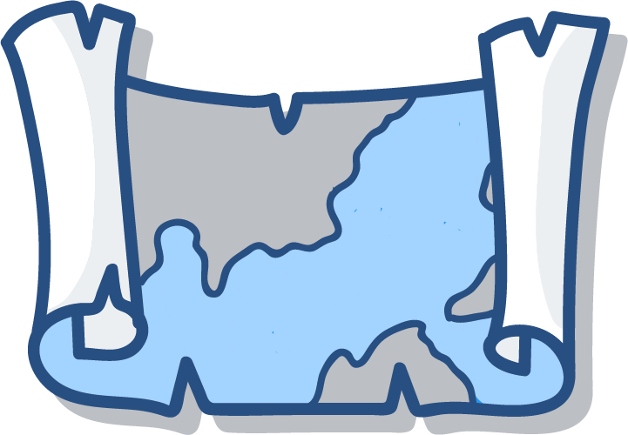

Samples are coded
1. Biobanks store information about the sample donors’ identity
2. Local biobanks send the personal identity numbers to a coordinating biobank, which then requests health data from the registries.
3. Coordinating biobank gives each participant a FinnGen code and sends it to the local biobank.
4. Local biobanks send the FinnGen coded samples to sample logistics laboratory which then sends the samples further to genome analysis.
5. Coded health registry data and genome data are delivered to the FinnGen study.
6. FinnGen combines the data and performs the analyses.
Notes:
Special attention has been paid to sample donor’s security and safety in the FinnGen research project. In practice, FinnGen study does not store or handle any personal identifier data.

Slide 28

Data protection
01
PARTICIPATION IS VOLUNTARY AND THE CONSENT CAN BE WITHDRAWN
02
SAMPLES ARE CODED AND FINNGEN CAN NOT IDENTIFY PARTICIPANTS
03
GENOME DATA, ANALYZED AND PRODUCED FROM BIOBANK SAMPLES, IS OWNED BY FINNISH BIOBANKS
Notes:
Sample donors have the right to know in which studies their sample has been used. Sample donors can withdraw their consent in any given time. The FinnGen study does not handle people's personal identification data, all data is encoded.

Slide 29
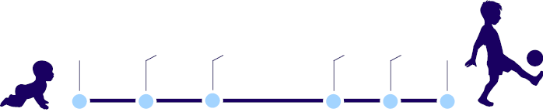
Drug development
TO USE
Identifying the molecule
Preclinical research
Clinical trials
Review
Approval
Universities,
biobanks
Pharmaceutical companies, universities
Laboratories, hospitals, doctors, pharmaceutical companies
10 YEAR JOURNEY
Notes:
What makes the FinnGen research unique is not only the use of Finnish gene pool, but also in the openness and scope of the cooperation. The FinnGen research project involves all the same actors as drug development: universities, hospitals, biobanks and pharmaceutical companies. With this open cooperation, we hope to speed up the emergence of new innovations.
https://www.fda.gov/forpatients/approvals/drugs/
https://en.wikipedia.org/wiki/Drug_development
http://www.ppdi.com/About/About-Drug-Discovery-and-Development

Slide 30
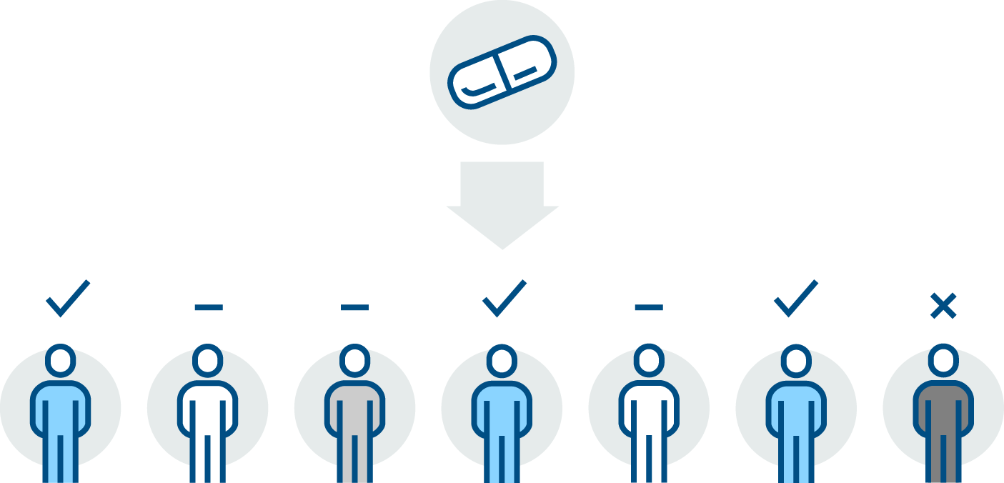


Personalized medicine
Medicine X
Traditional drug development 10–12 years
Patient benefits
No effect
Adverse effect
Notes:
Advances in a range of fields within medicine has changed how we classify diseases and how we make decisions regarding the right treatments. Personalized treatment aims to tailor the right treatment, at the right time, to the right patient, more and more precisely.

Slide 31
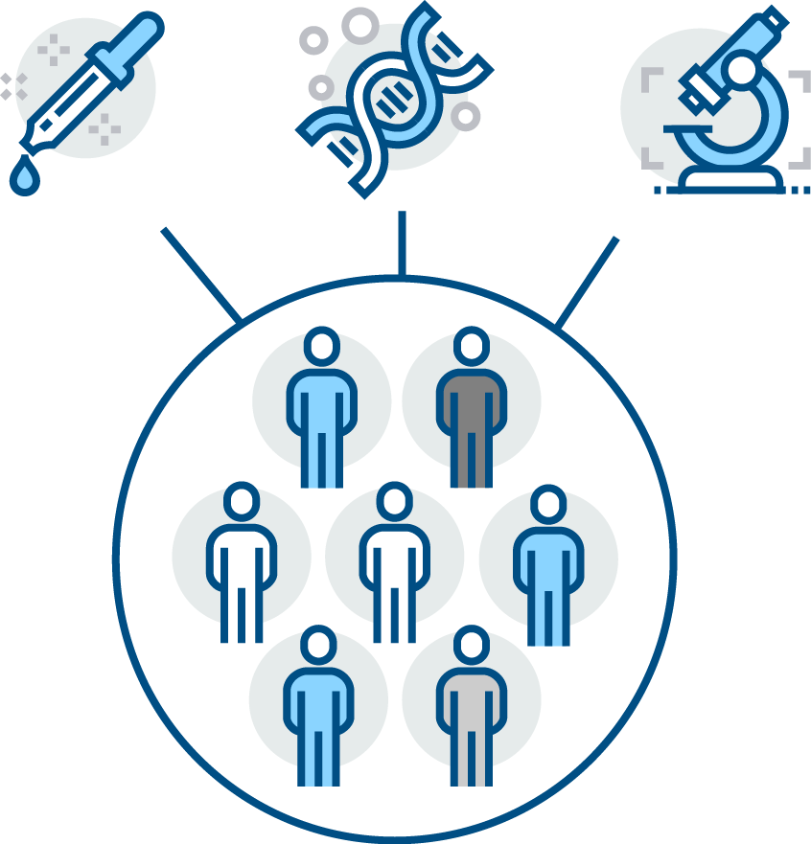

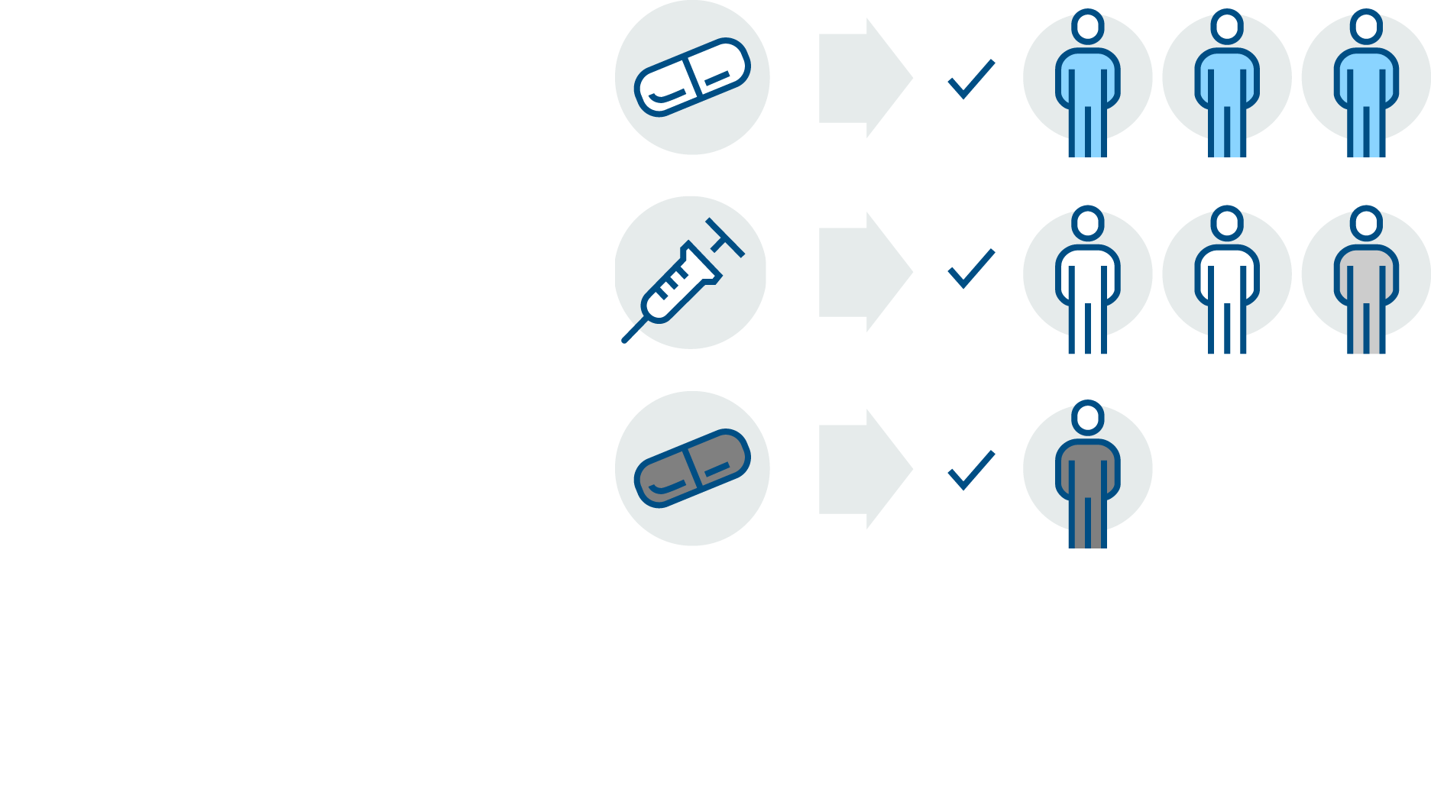
Personalized medicine
Personalized drug development can be up to 3-4 years faster.
→ reduced cost and faster health benefits
Notes:
Technological and scientific advances allow up to 4 years faster drug development than currently, meaning that the development of personalized medicine will reduce cost of care. Most importantly, costs will only incur from beneficial treatment. By helping in choosing the best treatment faster, personalized health care will benefit both the individual as well as society.

Slide 32
We welcome everyone on this journey into our shared heritage.
Notes:
To make the FinnGen research project successful and future solutions available to everyone, we need every effort to reach a common goal. We welcome everyone a common journey into our heritage.

Slide 33


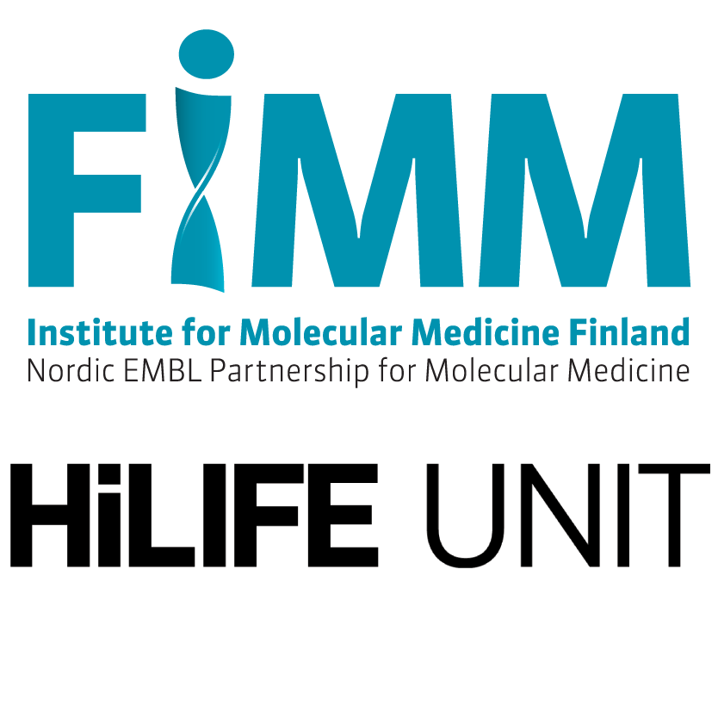
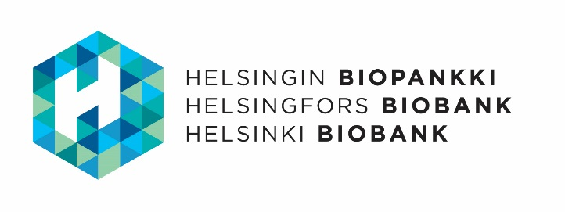
Coordinated by:

Slide 34







Funding partners:

Slide 35


In co-operation:
Hospital District of Southwest Finland
University of Turku
Satakunta Hospital District
Vaasa Hospital District
Hospital District of Helsinki and Uusimaa (HUS)
University of Helsinki
Kymenlaakso Social and Health Services (Carea)
South Karelia Social and Health Care District (Eksote)
Finnish Red Cross Blood Service
Finnish Association of Hematology
Institute for Molecular Medicine Finland (FIMM), HiLIFE, University of Helsinki

Slide 36
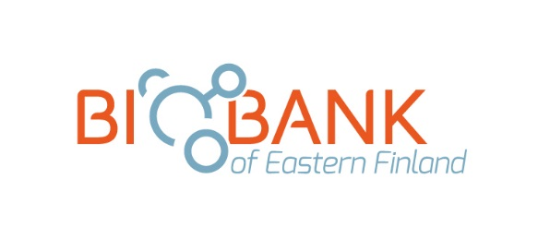


In co-operation:
Northern Savo Hospital District
University of Eastern Finland
South Savo Social and Health Care Authority
Joint Municipal Authority for North Karelia Social and Health services (Siun sote)
Eastern Savo Hospital District
Central Finland Health Care District
University of Jyväskylä
Northern Ostrobothnia Hospital District
University of Oulu
Nordlab
Central Ostrobothnia’s Joint Municipal Authority for Specialised Medical Care and Basic Services
Kainuu Social and Health Care Joint Municipal Authority
Lappi Hospital District
Länsi-Pohja Hospital District

Slide 37


In co-operation:
Pirkanmaa Hospital District
University of Tampere
Kanta-Häme Hospital District
South Ostrobothnia Hospital District
The National Institute of Health and Welfare
The Finnish Red Cross Blood Service

